Slide 1
Natural User Interface (NUI)
Mohammed Alnusayri
B00562801

Slide 2
Outline
Introduction to NUI
Different types of NUI:
  In air gesture interfaces
  Touch gesture interfaces
  Tangible tabletop interfaces
Conclusion
Activity

Slide 3
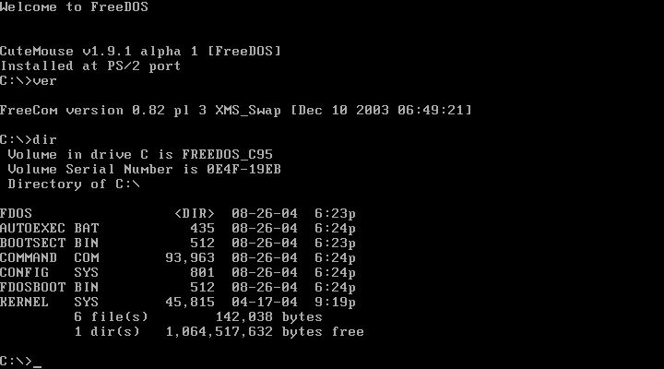
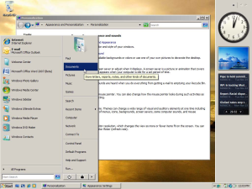
Introduction
Command line User Interface
Graphical User Interface
Google image
Notes:
When looking at the way that people interact with computer we can observe that it has been improved
In other word, the interfaces have been improved and gone through different phase.
Why do we need new interfaces? Creating documents using word processor in Command Line VS. GUI

Slide 4
Introduction
We must know:
  Each new UI will should overcome some of the limitations of the old one.
  Old UI will not be supplant by the new one.
  Each UI adapted to specific environments
Notes:
So, what are the limitations of GUI?

Slide 5
Naturel User Interfaces (NUI)
How are they natural?

Slide 6
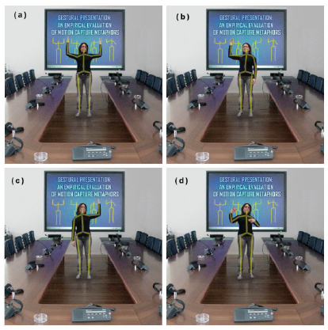
Naturel User Interfaces (NUI)
In air Gesture Interface
Can recognize different types of interactions in distance.
Kincet Presenter (KiP) uses Microsoft Kinect to control presentation software.
KiP command gestures [2]

Slide 7
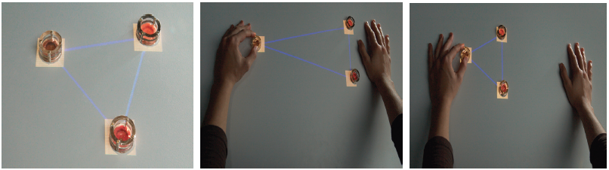
Naturel User Interfaces (NUI)
Tangible Tabletop Interface
Allows the user to interact with physical objects above the table.
There are two types:
  Electromagnetic TUI:
    It uses electromagnetic arrays that installed under the table surface to control the tangibles.
    It can be controlled by the user and the software.
Example of Pico [3]

Slide 8
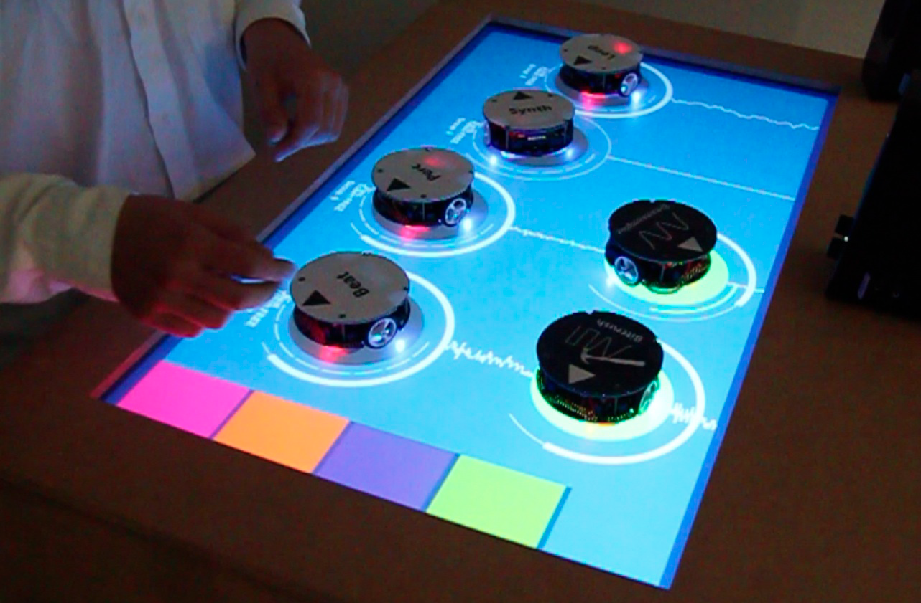
Naturel User Interfaces (NUI)
Tangible Tabletop Interface
  motorized TUI:
    It uses motorized tangibles that moves on the table surface.
    There are two types:
      Active tangibles: allow the user to interact with the tangibles without touching them
      Passive tangibles: the interaction done through direct touching.
Bidirectional version of mixiTUI that uses active tangibles [4]

Slide 9
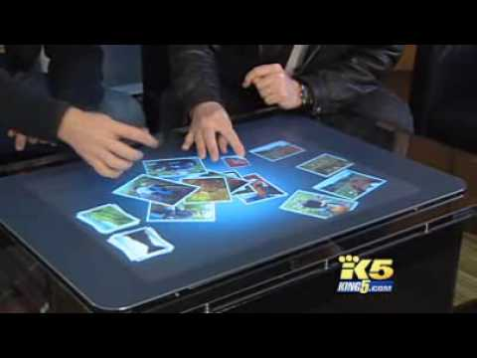
Naturel User Interfaces (NUI)
Touch Gesture Interface
It can be divided to three types:
  Single-user manipulation, which required only two points of contacts.
  Single-user gesture, which required a small number of points of contacts.
  Multi-user gesture, which required a large number of points of contacts.
Google image

Slide 10

Questions

Slide 11
Activity
You are going to develop In Air gesture interface to manipulate different functions that control your desktop, come up with different interactions technique to perform the following functions:
  Open a file
  Put two files in a new folder
  Move a file to an existing folder
  Create new folder
  Sort icons on desktop
http://www.youtube.com/watch?v=o4U1pzVf9hY

Slide 12
References
Wigdor, D., Wixon, D. Brave NUI World: designing natural user interfaces for touch and gesture. Morgan Kaufmann Publisher, Burlington, 2011
Stefania Cuccurullo, Rita Francese, Sharefa Murad, Ignazio Passero, and Maurizio Tucci. 2012. A gestural approach to presentation exploiting motion capture metaphors. In Proceedings of the International Working Conference on Advanced Visual Interfaces (AVI '12), Genny Tortora, Stefano Levialdi, and Maurizio Tucci (Eds.). ACM, New York, NY, USA, 148-155.DOI=10.1145/2254556.2254584 http://doi.acm.org/10.1145/2254556.2254584
James Patten and Hiroshi Ishii. 2007. Mechanical constraints as computational constraints in tabletop tangible interfaces. In Proceedings of the SIGCHI Conference on Human Factors in Computing Systems (CHI '07). ACM, New York, NY, USA, 809-818. DOI=10.1145/1240624.1240746 http://doi.acm.org/10.1145/1240624.1240746

Slide 13
References
Esben Warming Pedersen and Kasper Hornbæk. 2011. Tangible bots: interaction with active tangibles in tabletop interfaces. In Proceedings of the SIGCHI Conference on Human Factors in Computing Systems (CHI '11). ACM, New York, NY, USA, 2975-2984. DOI=10.1145/1978942.1979384 http://doi.acm.org/10.1145/1978942.1979384
Google images

