Slide 1
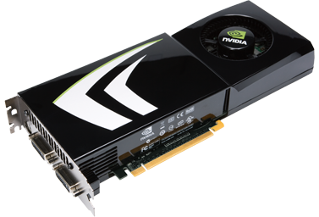
GPU: Basic CUDA programming

Slide 3
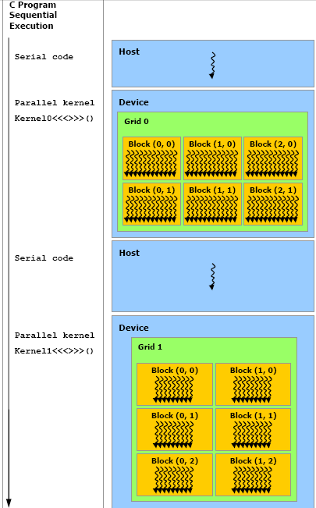

Slide 5
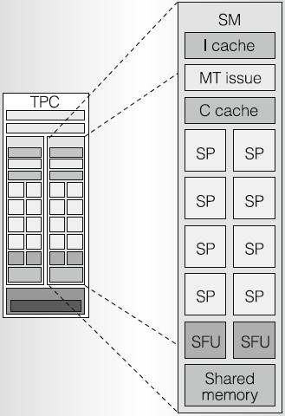
Thread execution
Threads are executed in groups of 32, called “warps”
Each SM executes one warp at a time
Each core (SP) switches between 4 thread for latency hiding
All threads in a warp are executed SIMD style

Slide 9
