Slide 1
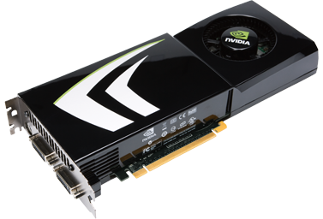
GPU: Architecture overview

Slide 3
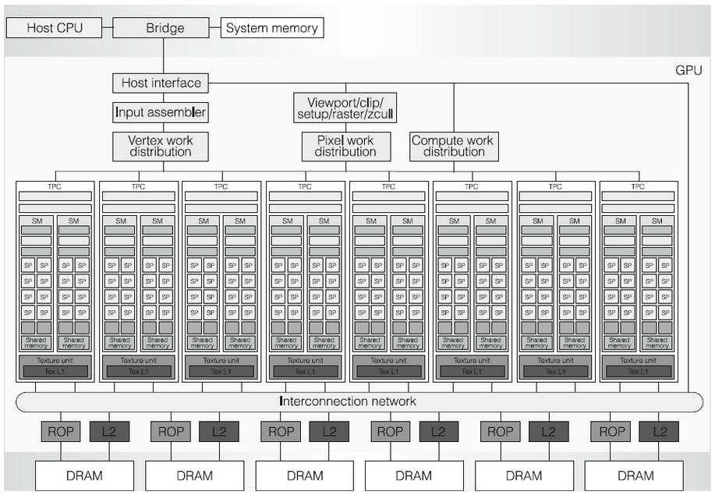

Slide 10
16 SMs
32 cores per SM

