Slide 1
Intro to Cloud Computing
Andrew Rau-Chaplin
Adapted from What is Cloud Computing? (and an intro to parallel/distributed processing), Jimmy Lin, The iSchool University of Maryland
Some material adapted from slides by Christophe Bisciglia, Aaron Kimball, & Sierra Michels-Slettvet,

Slide 2
Source: http://www.free-pictures-photos.com/

Slide 3
Web Applications
Virtual ization
Large Data Centers
Big Data

Slide 4
Some Characteristics
Elasticity/Scalability
Virtualization
Fully scripted deployment
Multi-tenancy
Monitored performance
Device and location independence
Cost: efficiency & reduction in capital

Slide 5
Cloud Computing
Use cases
Engineering the cloud
Models
Applications
Software

Slide 6
Use Cases
Characteristics:
Definitely data-intensive
May also be processing intensive
Examples:
Crawling, indexing, searching, mining the Web
“Post-genomics” life sciences research
Other scientific data (physics, astronomers, etc.)
Sensor networks
Web 2.0 applications
…

Slide 7
Primary Motivations
Too much data
Elastic Demand
Growing globally distributed user base
Cost
Our core business is not infrastructure

Slide 8
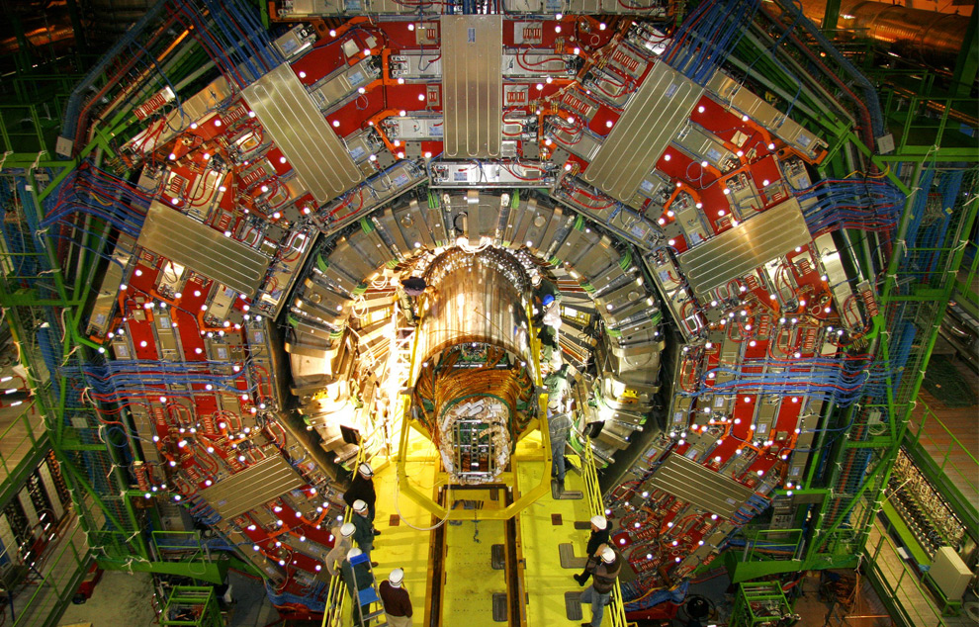
Too much data?
Maximilien Brice, © CERN

Slide 9
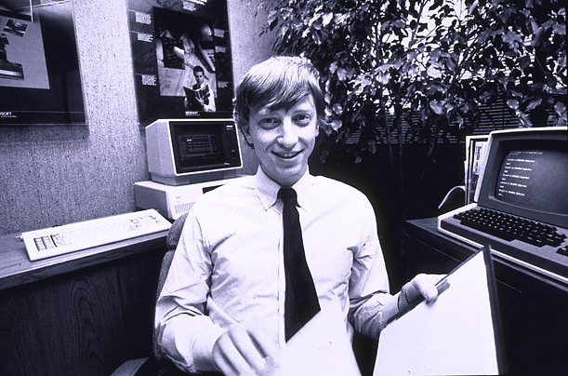
How much data?
Wayback Machine has 2 PB + 20 TB/month (2006)
Google processes 20 PB a day (2008)
“all words ever spoken by human beings” ~ 5 EB
NOAA has ~1 PB climate data (2007)
CERN’s LHC will generate 30 PB a year (2013), 100 PB on tape.
For better or worse: 90% of world's data generated over last two years
640K ought to be enough for anybody.

Slide 10
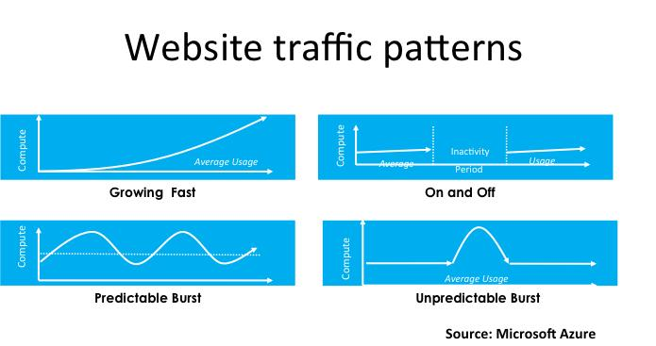
2. Elastic Demand

Slide 11
2. Elastic demand: Examples
Growth
NewCo
Seasonal
Retail: Christmas
Service: Tax season
Business Specific: Contract renewals
Burst
Turn on the machine
Instantaneous
The web

Slide 12
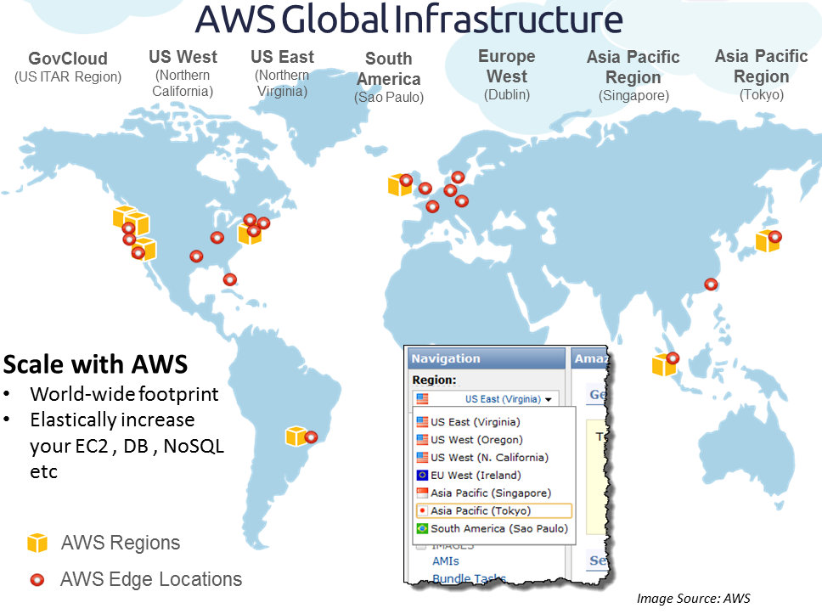
3. Global Enterprise
Elasticity between zones
Cheaper to move compute than data!
Disaster recovery

Slide 13
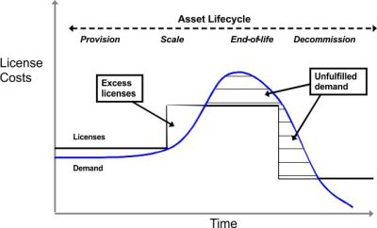
4. Cost
The waste in ownership

Slide 14
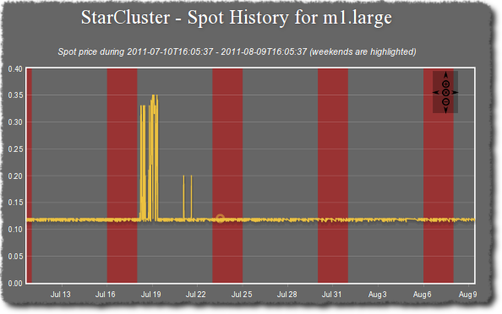
4. Cost
Pay for what you need!
The spot market

Slide 15
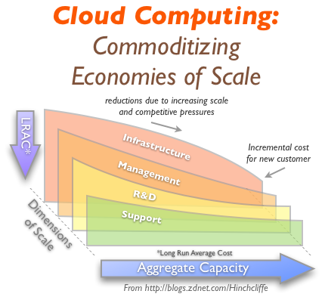
5. Infrastructure is NOT our business!
Economy of scale
Automated deployment

Slide 16
Cloud Computing
Use cases
Engineering the cloud
Models
Applications
Software

Slide 17
Engineering the cloud
Web-scale problems? Throw more machines at it!
Clear trend: centralization of computing resources in large data centers
Necessary ingredients: fiber, juice, and space
What do Oregon, Iceland, and abandoned mines have in common?
Important Issues:
Redundancy
Efficiency
Utilization
Management

Slide 18
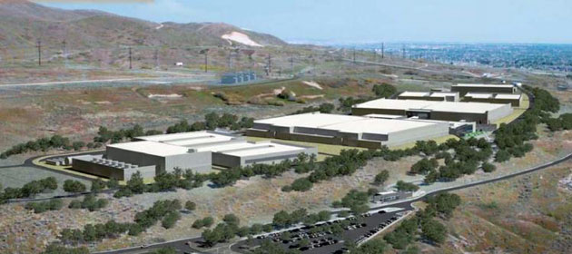
Example: Utah Data Center
100,000 racks
10+ exabytes of data
75 megawatts of poswer

Slide 19
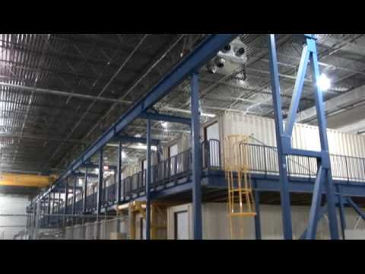
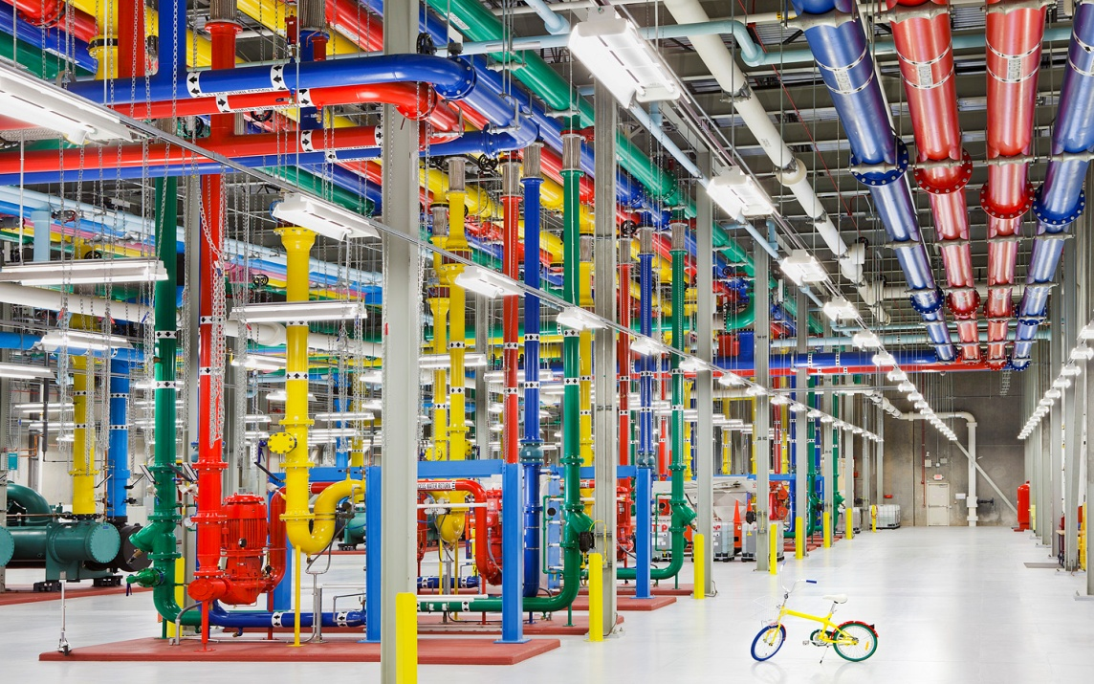
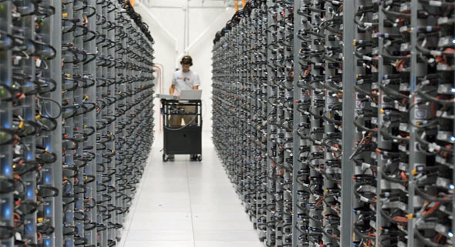
Google container data center tour
http://www.youtube.com/watch?v=zRwPSFpLX8I
https://www.youtube.com/watch?v=avP5d16wEp0

Slide 20
Key Technology: Virtualization
App
App
App
App
App
App
OS
OS
OS
Operating System
Hypervisor
Hardware
Hardware
Traditional Stack
Virtualized Stack

Slide 21
Cloud Computing
Use cases
Engineering the cloud
Models
Applications
Software

Slide 22
Models
“Why do it yourself if you can pay someone to do it for you?”
Infrastructure as a Service (IaaS)(Utility computing)
Why buy machines when you can rent cycles?
Examples: Amazon’s EC2, GoGrid, AppNexus
Platform as a Service (PaaS)
Give me nice API and take care of the implementation
Example: Google App Engine
Software as a Service (SaaS)
Just run it for me!
Example: Gmail

Slide 23
Cloud Computing
Use cases
Engineering the cloud
Models
Applications
Software

Slide 24
Cloud Applications
A mistake on top of a hack built on sand held together by duct tape?
What is the nature of software applications?
From the desktop to the browser
SaaS == Web-based applications
Examples: Google Maps, Facebook
How do we deliver highly-interactive Web-based applications?
AJAX (asynchronous JavaScript and XML)
For better, or for worse…

Slide 25
Typical Cloud Applications
Web application
Big Science
Big Data
Soon most applications…

Slide 26
Typical Cloud Applications
All the old applications, Plus
New application made possible by new computing infrastructure
Web application
Big Science
Big Data
Example: Big Data

Slide 27
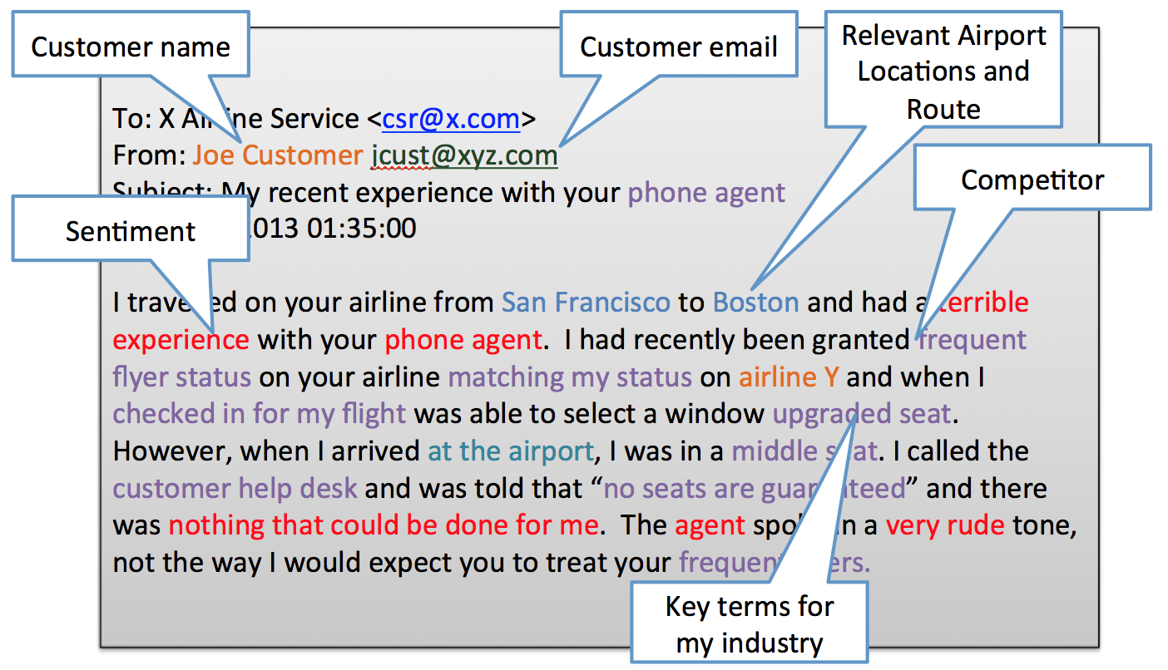
Text Analytics: Example
Applications
Enterprise Business Intelligence/Data Mining, Competitive Intelligence
E-Discovery, Records Management
National Security/Intelligence
Scientific discovery, especially Life Sciences
Sentiment Analysis Tools, Listening Platforms
Natural Language/Semantic Toolkit or Service
Publishing
Automated ad placement
Search/Information Access
Social media monitoring
Types of Analysis
Sentiment Analysis
Named Entity Recognition
Recognition of Pattern Identified Entities
Classification

Slide 28
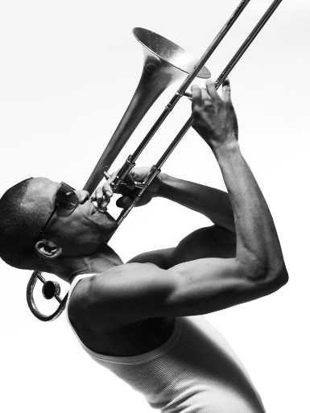
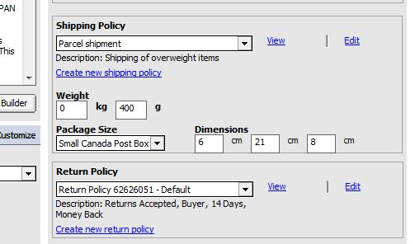
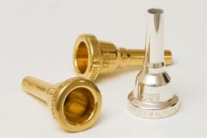
Data Analytics: Example
How big is a trombone?
How much does it weight?
How can it be shipped?
I said a trombone not a trombone mouthpiece!

Slide 29
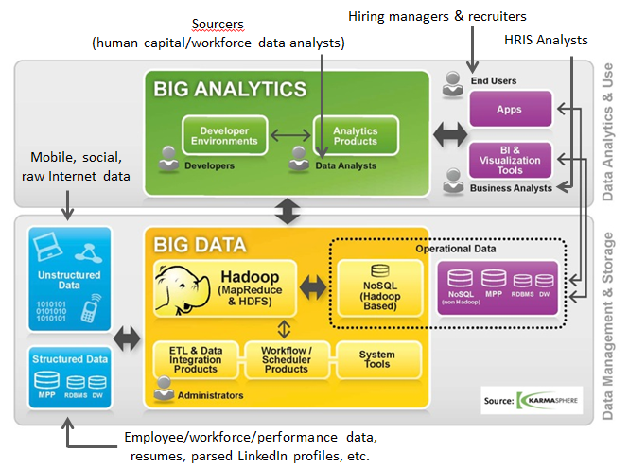
HR: Example

Slide 30
Data Analysis Vs Analytics

Slide 31
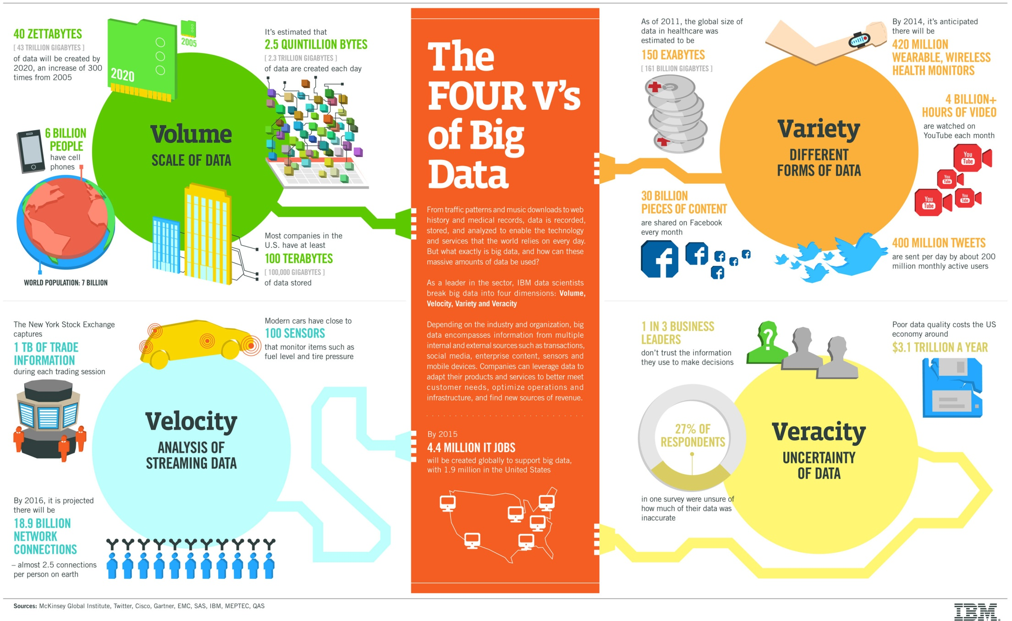
The four V’s

Slide 32
Cloud Computing
Use cases
Engineering the cloud
Models
Applications
Software

Slide 33
Cloud Software
Intro
Example: AWS
Management Stacks
Big Data Stacks
Communications
Synchronization
HPC on Clouds

Slide 34
Cloud Scale
Clouds – a pragmatic marshalling of existing technologies
It all boils down to…
Scriptable configuration and management
Throwing more hardware at the problem
Divide-and-conquer

Slide 35
Different Levels of Parallelism
Different threads in the same core
Different cores in the same CPU
Different CPUs in a multi-processor system
Different machines in a distributed system

Slide 36
Divide and Conquer
“Work”
Partition
w₁
w₂
w₃
“worker”
“worker”
“worker”
r₁
r₂
r₃
Combine
“Result”

Slide 37
Example: Amazon Web Services
Elastic Compute Cloud (EC2)
Rent computing resources by the hour
Basic unit of accounting = instance-hour
Additional costs for bandwidth
Simple Storage Service (S3)
Persistent storage
Charge by the GB/month
Additional costs for bandwidth

Slide 38
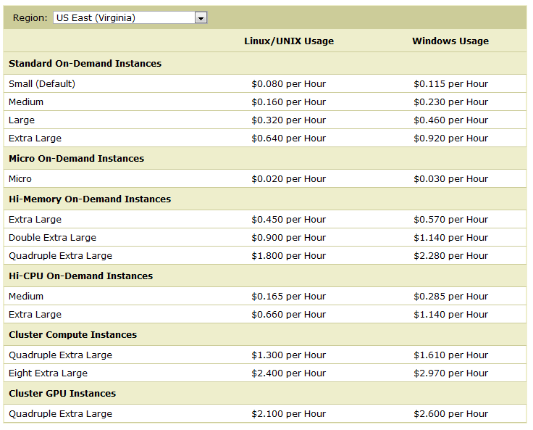

Slide 39
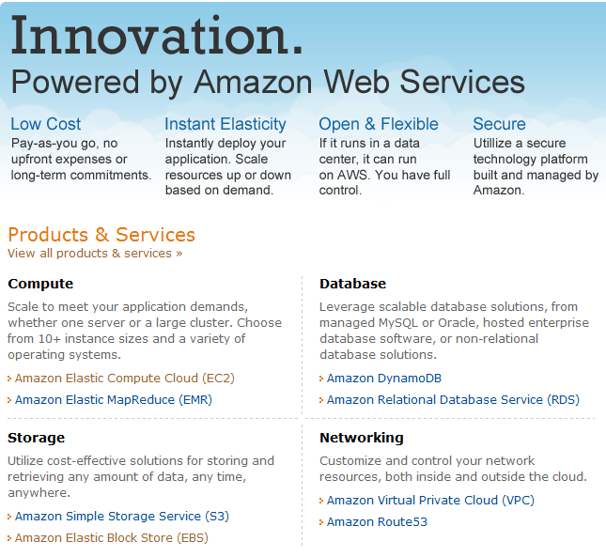

Slide 40
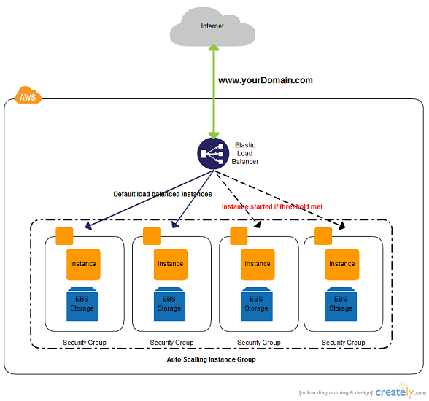
Typical AWS Architecture

Slide 41
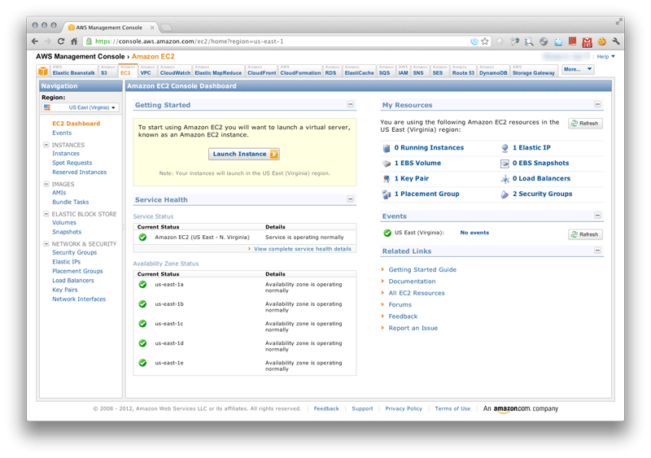

Slide 42
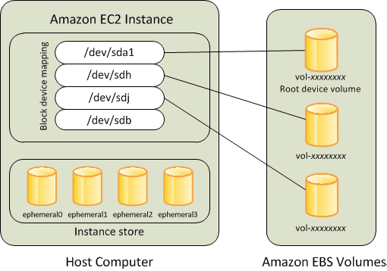
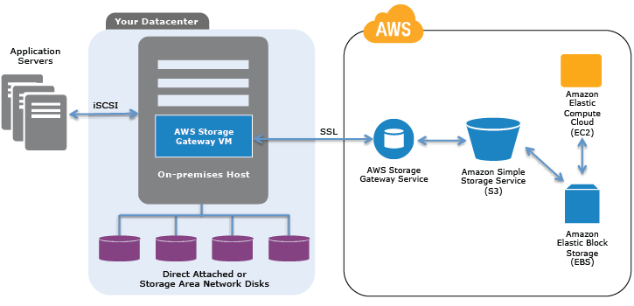
Storage: EBS Vs S3
EBS can only be used with EC2 instances while S3 can be used outside EC2
EBS appears as a mountable volume while the S3 requires software to read and write data
EBS can accommodate a smaller amount of data than S3
EBS can only be used by one EC2 instance at a time while S3 can be used by multiple instances
S3 typically experiences write delays while EBS does not

Slide 43
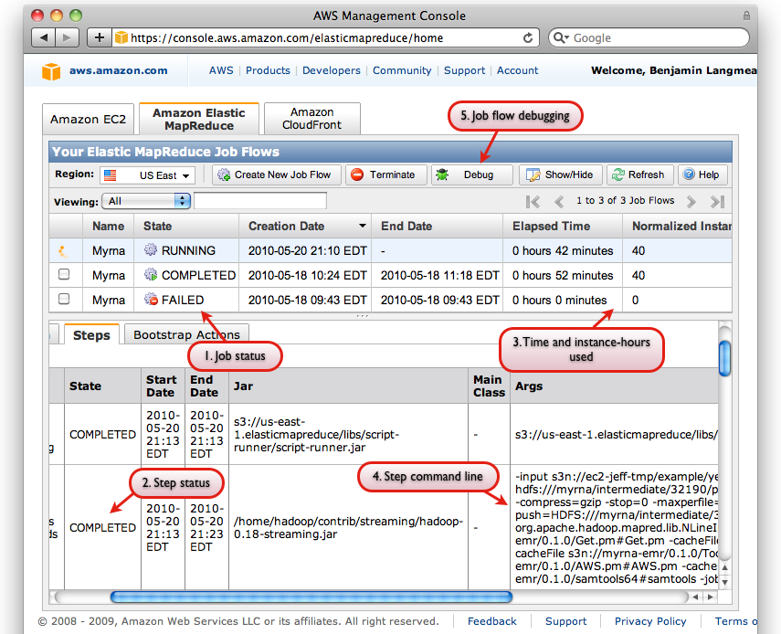
Elastic MapReduce

Slide 44
Demo of Amazon Services
Other Cloud Vendors
Google, Oracle Cloud, Salesforce, Microsoft….

Slide 45
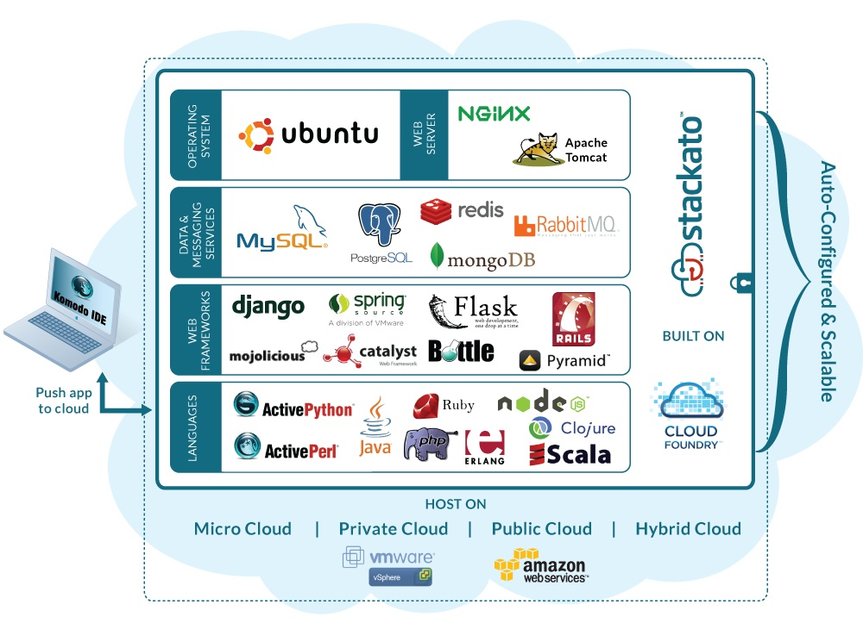
Cloud Management Stacks
The software integration problem!

Slide 46
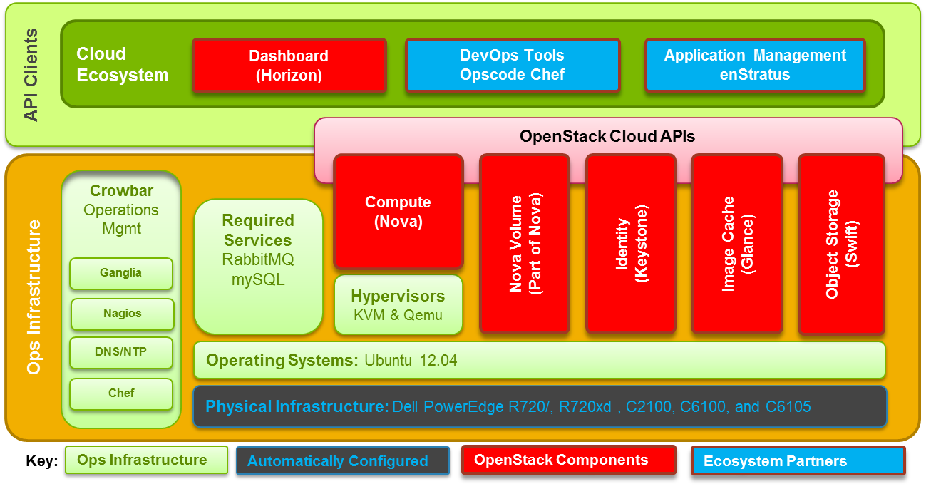
Cloud Stacks
Many, including Apache CloudStack, Eucalyptus
Example: OpenStack

Slide 47
Big Data Stacks

Slide 48
Communication on the Cloud

Slide 49
Synchronization on the Cloud

Slide 50
HPC & the Cloud
Star Cluster - http://star.mit.edu/cluster
HPC in the Cloud - http://www.hpcinthecloud.com/
Amazon
HPC on AWS - http://aws.amazon.com/hpc-applications/
Cluster Compute Instances - http://aws.amazon.com/ec2/instance-types/ , http://aws.amazon.com/dedicated-instances/

