Slide 1
Benchmarking Parallel Code

Slide 2
Benchmarking
What are the performance characteristics of a parallel code?
What should be measured?

Slide 3
Experimental Studies
Write a program implementing the algorithm
Run the program with inputs of varying size and composition
Use “system clock” to get an accurate measure of the actual running time
Plot the results

Slide 4
Experimental Dimensions
Time
Space
Number of processors
InputData(n,_,_,_)
Results(_,_)

Slide 5
Features of a good experiment?
What are features of every good experiment?

Slide 6
Features of a good experiment
Reproducibility
Quantification of performance
Exploration of anomalies
Exploration of design choices
Capacity to explain deviation from theory

Slide 7
Types of experiments
Time and Speedup
Scaleup
Exploration of data variation

Slide 8
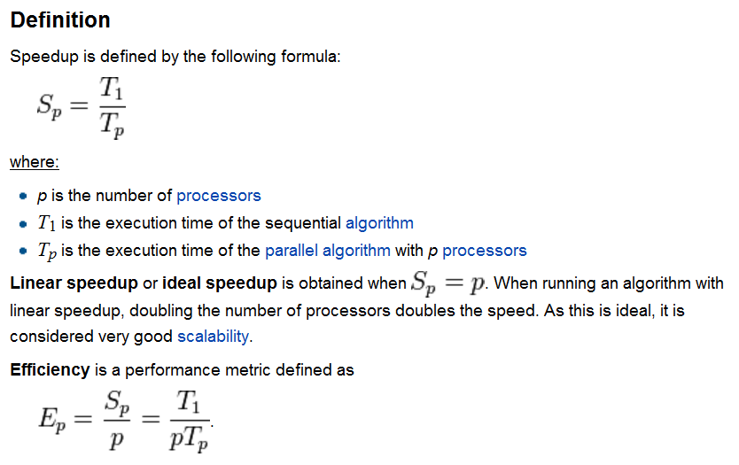
Speedup

Slide 9
Time and Speedup
fixed data(n,_,_,…)
fixed data(n,_,_,…)
linear
time
speedup
processors
processors

Slide 10
Superlinear Speedup
Is this possible?
Theoretical, No
What is T₁?
In Practice, yes
Cache effects
“Relative Speedup” T₁= parallel code on 1 process without communications
fixed data(n,_,_,…)
linear
processors

Slide 11
How to lie about Speedup?
Cripple the sequential program!
This is a *very* common practice
People compare the performance of their parallel program on p processors to its performance on 1 processor, as if this told you something you care about, when in reality their parallel program on one processor runs *much* slower than the best known sequential program does.
Moral: anytime anybody shows you a speedup curve, demand to know what algorithm they're using in the numerator.

Slide 12
Sources of Speedup Anomalies
Reduced overhead -- some operations get cheaper because you've got fewer processes per processor
Increasing cache size -- similar to the above: memory latency appears to go down because the total aggregate cache size went up
Latency hiding -- if you have multiple processes per processor, you can do something else while waiting for a slow remote op to complete
Randomization -- simultaneous speculative pursuit of several possible paths to a solution
It should be noted that anytime "superlinear" speedup occurs for reasons 3 or 4, the sequential algorithm could (given free context switches) be made to run faster by mimicking the parallel algorithm.

Slide 13
Sizeup
fixed p, data(_,_,…)
What happens
when n grows?
time
n

Slide 14
Scaleup
fixed n/p, data(_,_,…)
What happens
when p grows, given a fixed ration n/p?
time
p

Slide 15
Exploration of data variation
Situation dependent
Let’s look at an example…

Slide 16
Example of Benchmarking
See http://web.cs.dal.ca/~arc/publications/1-20/paper.pdf
We have implemented our optimized data partitioning method for shared-nothing data
cube generation using C++ and the MPI communication library. This implementation
evolved from (Chen, et.al. 2004), the code base for a fast sequential Pipesort (Dehne, et.al.
2002) and the sequential partial cube method described in (Dehne, et.al. 2003). Most of the
required sequential graph algorithms, as well as da ta structures like hash tables and graph
representations, were drawn from the LEDA library (LEDA, 2001).

Slide 17
Describe the implementation:
We have implemented our optimized data partitioning method for shared-nothing data
cube generation using C++ and the MPI communication library. This implementation
evolved from (Chen, et.al. 2004), the code base for a fast sequential Pipesort (Dehne, et.al.
2002) and the sequential partial cube method described in (Dehne, et.al. 2003). Most of the
required sequential graph algorithms, as well as da ta structures like hash tables and graph
representations, were drawn from the LEDA library (LEDA, 2001).

Slide 18
Describe the Machine:
Our experimental platform consists of a 32 node Beowulf style cluster with 16 nodes
based on 2.0 GHz Intel Xeon processors and 16 more nodes based on 1.7 GHz Intel Xeon
processors. Each node was equipped with 1 GB RAM, two 40GB 7200 RPM IDE disk
drives and an onboard Inter Pro 1000 XT NIC. Each node was running Linux Redhat 7.2
with gcc 2.95.3 and MPI/LAM 6.5.6. as part of a ROCKS cluster distribution. All nodes
were interconnected via a Cisco 6509 GigE switch.

Slide 19
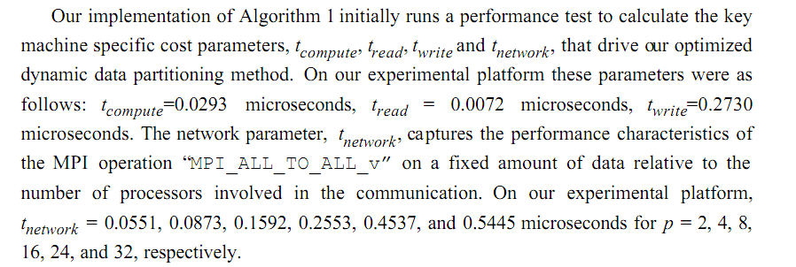
Describe how any tuning parameters where defined:
Our implementation of Algorithm 1 initially runs a performance test to calculate the key
machine specific cost parameters, t
compute
, t
read
, t
write
and t
network
, that drive our optimized
dynamic data partitioning method. On our experimental platform these parameters were as
follows: t
compute=0.0293 microseconds, t
read
= 0.0072 microseconds, twrite=0.2730
microseconds. The network parameter, t
network
, captures the performance characteristics of
the MPI operation “MPI_ALL_TO_ALL_v” on a fixed amount of data relative to the
number of processors involved in the communication. On our experimental platform,
t
network
= 0.0551, 0.0873, 0.1592, 0.2553, 0.4537, and 0.5445 microseconds for p = 2, 4, 8,
16, 24, and 32, respectively.

Slide 20
Describe the timing methodology:

Slide 21
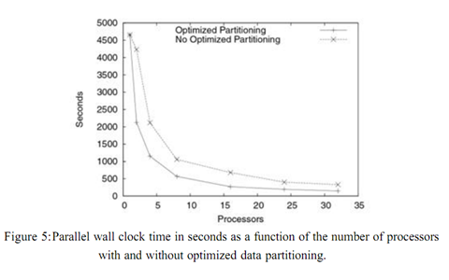
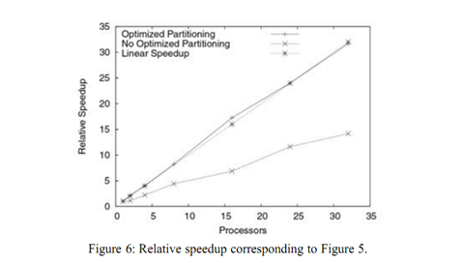
Describe Each Experiment

Slide 22
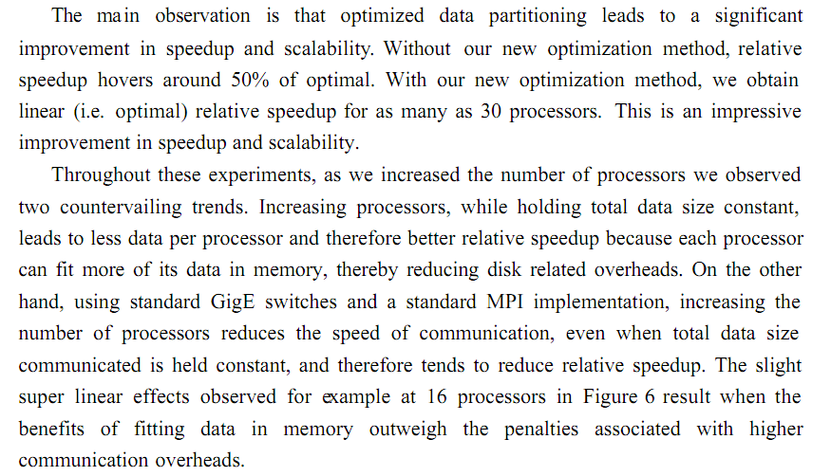
Analyze the results of each experiment

Slide 23
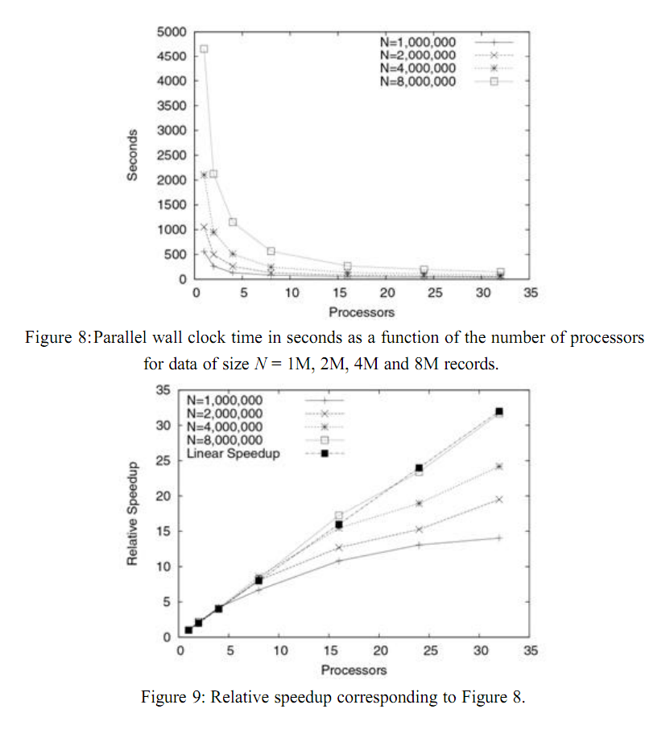
Look at Speedup

Slide 24
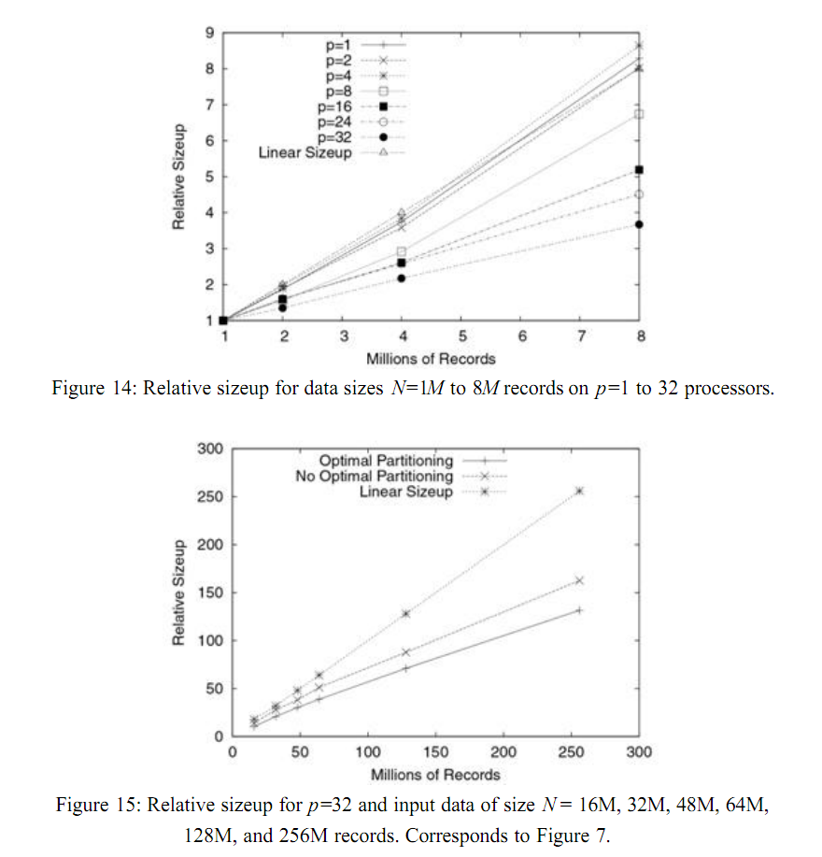
Look at Sizeup

Slide 25
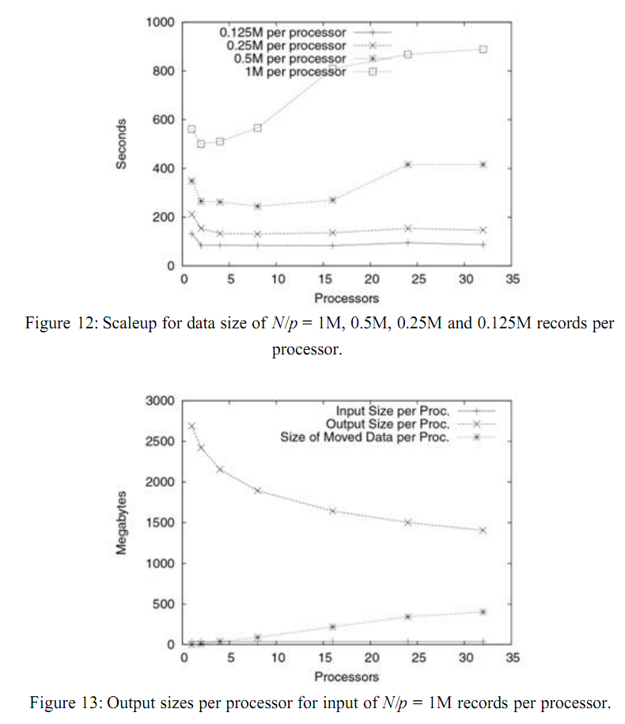
Consider Scaleup

Slide 26
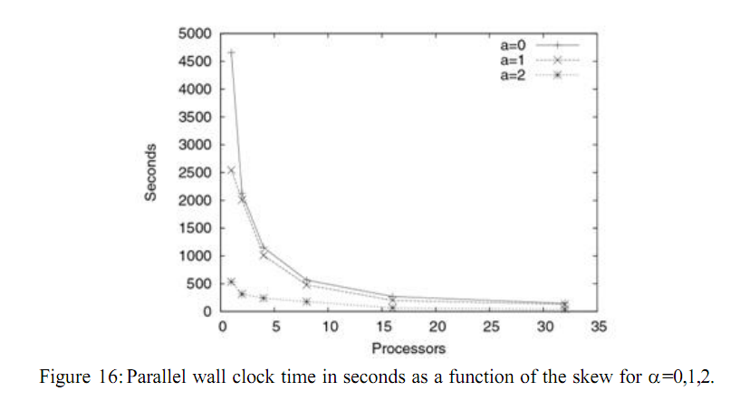
Consider Application Specific Parameters

Slide 27
Typical Outline of a Parallel Computing Paper
Intro & Motivation
Description of the Problem
Description of the Proposed Algorithm
Analysis of the Proposed Algorithm
Description of the Implementation
Performance Evaluation
Conclusion & Future Work

