Slide 1
Analysis of Performance
Input
Algorithm
Output

Slide 2
Talking about Performance
Models
Exact
Asymptotic
Experiments
Time
Speedup
Efficiency
Scale-up

Slide 3
How would you compare?
Sort Code A vs. Sort Code B?
Algorithm A vs. Algorithm B?
What does it mean to be
a “Good Code”?
a “Good Algorithm”?

Slide 4
Running Time
The running time of an algorithm varies with the input and typically grows with the input size
Average case difficult to determine
We focus on the worst case running time
Easier to analyze
Crucial to applications such as games, finance and robotics

Slide 5
Experimental Studies
Write a program implementing the algorithm
Run the program with inputs of varying size and composition
Use “system clock” to get an accurate measure of the actual running time
Plot the results

Slide 6
What Experiments?
Example: Updating an OLAP Cube
New Tables
D1 | D2 | … | Ds | M1 | M2 | … | Mr
Existing Tables

Slide 7
Limitations of Experiments
It is necessary to implement the algorithm, which may be difficult
Results may not be indicative of the running time on other inputs not included in the experiment.
In order to compare two algorithms, the same hardware and software environments must be used

Slide 8
Asymptotic Analysis
Uses a high-level description of the algorithm instead of an implementation
Takes into account all possible inputs
Allows us to evaluate the speed of an algorithm independent of the hardware/software environment
A back of the envelope calculation!!!

Slide 9
The idea
Write down an algorithm
Using Pseudocode
In terms of a set of primitive operations
Count the # of steps
In terms of primitive operations
Considering worst case input
Bound or “estimate” the running time
Ignore constant factors
Bound fundamental running time

Slide 10
Primitive Operations
Basic computations performed by an algorithm
Identifiable in pseudocode
Largely independent from the programming language
Exact definition not important (we will see why later)
Examples:
Evaluating an expression
Assigning a value to a variable
Indexing into an array
Calling a method
Returning from a method

Slide 11
Counting Primitive Operations
By inspecting the pseudocode, we can determine the maximum number of primitive operations executed by an algorithm, as a function of the input size
Algorithm arrayMax(A, n)
# operations
currentMax ← A[0] 2
for i ← 1 to n − 1 do 2 + n
if A[i] > currentMax then 2(n − 1)
currentMax ← A[i] 2(n − 1)
{ increment counter i } 2(n − 1)
return currentMax 1
Total 7n − 1

Slide 12
Estimating Running Time
Algorithm arrayMax executes 7n − 1 primitive operations in the worst case
Define
a Time taken by the fastest primitive operation
b Time taken by the slowest primitive operation
Let T(n) be the actual worst-case running time of arrayMax. We have a (7n − 1) ≤ T(n) ≤ b(7n − 1)
Hence, the running time T(n) is bounded by two linear functions

Slide 13
Growth Rate of Running Time
Changing the hardware/ software environment
Affects T(n) by a constant factor, but
Does not alter the growth rate of T(n)
The linear growth rate of the running time T(n) is an intrinsic property of algorithm arrayMax

Slide 14
Which growth rate is best?
T(n) = 1000n + n² or T(n) = 2n + n³

Slide 15
Growth Rates
Growth rates of functions:
Linear ≈ n
Quadratic ≈ n²
Cubic ≈ n³
In a log-log chart, the slope of the line corresponds to the growth rate of the function

Slide 16
Constant Factors
The growth rate is not affected by
constant factors or
lower-order terms
Examples
10²n + 10⁵ is a linear function
10⁵n² + 10⁸n is a quadratic function

Slide 17
Big-Oh Notation
Given functions f(n) and g(n), we say that f(n) is O(g(n)) if there are positive constants c and n₀ such that
f(n) ≤ cg(n) for n ≥ n₀
Example: 2n + 10 is O(n)
2n + 10 ≤ cn
(c − 2) n ≥ 10
n ≥ 10/(c − 2)
Pick c = 3 and n₀ = 10

Slide 18
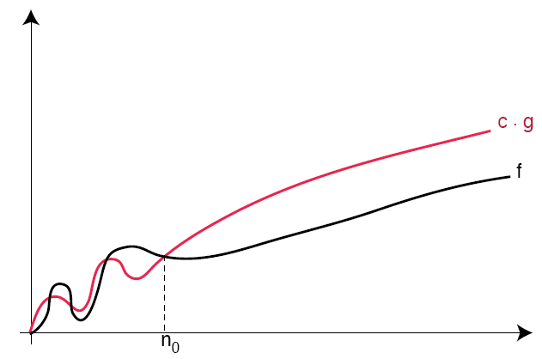
f(n) is O(g(n)) iff f(n) ≤ cg(n) for n ≥ n₀

Slide 19
Big-Oh Notation (cont.)
Example: the function n² is not O(n)
n² ≤ cn
n ≤ c
The above inequality cannot be satisfied since c must be a constant

Slide 20
Big-Oh and Growth Rate
The big-Oh notation gives an upper bound on the growth rate of a function
The statement “f(n) is O(g(n))” means that the growth rate of f(n) is no more than the growth rate of g(n)
We can use the big-Oh notation to rank functions according to their growth rate

Slide 21
Questions
Is T(n) = 9n⁴ + 876n = O(n⁴)?
Is T(n) = 9n⁴ + 876n = O(n³)?
Is T(n) = 9n⁴ + 876n = O(n²⁷)?
T(n) = n² + 100n = O(?)
T(n) = 3n + 32n³ + 767249999n² = O(?)

Slide 22
Classes of Functions
Let {g(n)} denote the class (set) of functions that are O(g(n))
We have {n} ⊂ {n²} ⊂ {n³} ⊂ {n⁴} ⊂ {n⁵} ⊂ … where the containment is strict
{n³}
{n²}
{n}

Slide 23
Big-Oh Rules
If is f(n) a polynomial of degree d, then f(n) is O(n^{d}), i.e.,
Drop lower-order terms
Drop constant factors
Use the smallest possible class of functions
Say “2n is O(n)” instead of “2n is O(n²)”
Use the simplest expression of the class
Say “3n + 5 is O(n)” instead of “3n + 5 is O(3n)”

Slide 24
Asymptotic Algorithm Analysis
The asymptotic analysis of an algorithm determines the running time in big-Oh notation
To perform the asymptotic analysis
We find the worst-case number of primitive operations executed as a function of the input size
We express this function with big-Oh notation
Example:
We determine that algorithm arrayMax executes at most 7n − 1 primitive operations
We say that algorithm arrayMax “runs in O(n) time”
Since constant factors and lower-order terms are eventually dropped anyhow, we can disregard them when counting primitive operations

Slide 25
Rank From Fast to Slow…
T(n) = O(n⁴)
T(n) = O(n log n)
T(n) = O(n²)
T(n) = O(n² log n)
T(n) = O(n)
T(n) = O(2^{n})
T(n) = O(log n)
T(n) = O(n + 2n)
Note: Assume base of
log is 2 unless
otherwise instructed
i.e. log n = log₂ n

