Slide 1
Architectures & Performance

Slide 2
Outline
Architectural Approaches
Processor Architectures
Current Trends

Slide 3
Architectures & Parallelism
A long history – starts in the 50’s
Approaches tried
Implicit parallelism – CPU Pipelining
Vector Processors
SIMD Machines
“Regular Architectures”
Shared Memory - UMA
Shared Memory - NUMA
Clusters

Slide 4
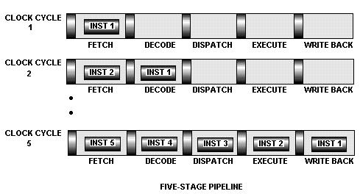
1) Implicit parallelism – CPU Pipelining
Assembly line parallelism
What do you do on branch?
All modern CPUs are pipelined

Slide 5
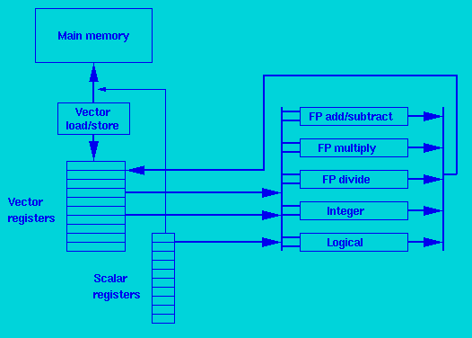
2) Vector Processors
Supercomputers (Cray)
High-level operations on vectors (50-100)
Scientific computations of matrices
Unwinding loops
Compiler driven

Slide 6
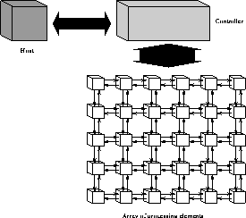
3) SIMD Machines
Single Instruction, Multiple Data (SIMD)
One control unit
Single “heart beat”
Many PEs
Thinking Machine’s CM2 – 64K single bit processors

Slide 7
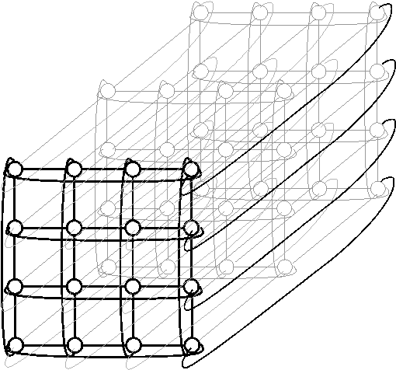
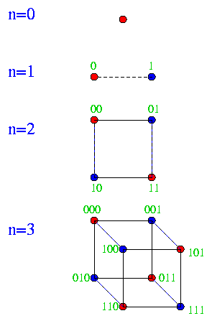
4) “Regular” Architectures
Fixed interconnection topology
Distance = # of hops
Ring, tree, mesh, hypercube, etc
Network topology maybe explicit or implicit in programming model
CM5, IBM SP2, Cray T3E, …

Slide 8
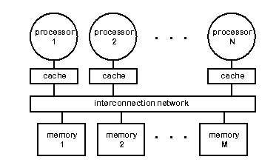
5) Shared Memory - UMA
SMP – Symmetric Multi Processor
Great programming model
Hard to build, very hard to scale beyond 16-24 processors!
Snoopy caching schemes – listen to the bus!

Slide 9
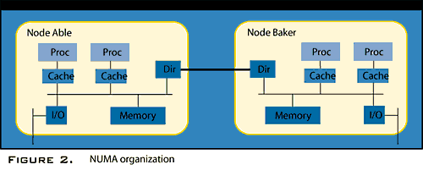
6) Shared Memory NUMA
Non-Uniform Memory Access
A bunch of connected SMPs with hardware supported distributed caches
Much more scalable!

Slide 10
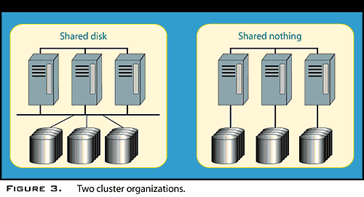
7) Clusters
Distributed Memory
Typical commodity multiprocessors/Networks
Beowulf
Message passing

Slide 11
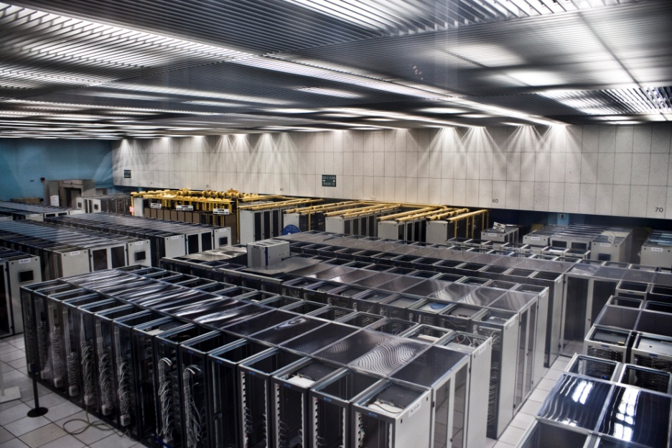
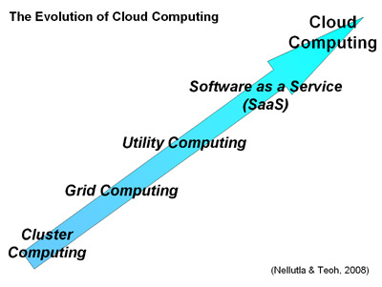
8) Clouds

Slide 12
Outline
Architectural Approaches
Processor Architectures
Current Trends

Slide 18
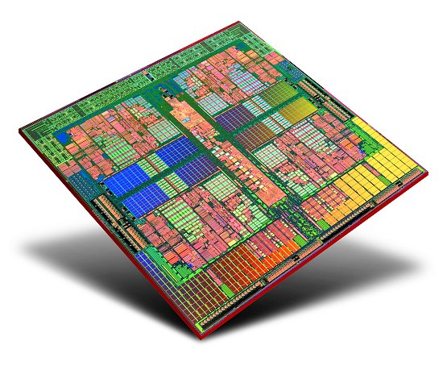

Slide 20
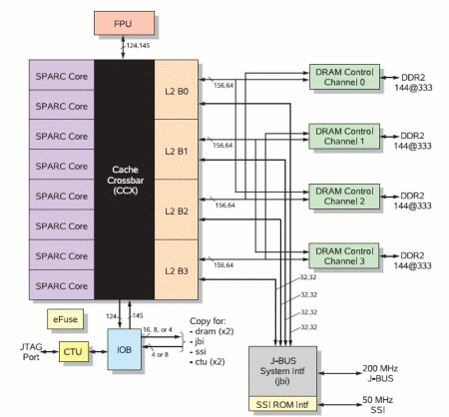
SUN UltraSPARC T1/T2
8 cores
4/8 hardware supported threads per core
32/64 hardware supported threads

Slide 21
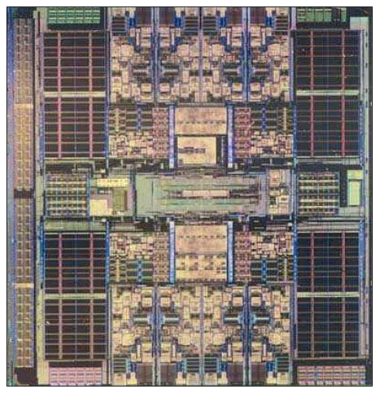
SUN UltraSPARC T1/T2

Slide 23
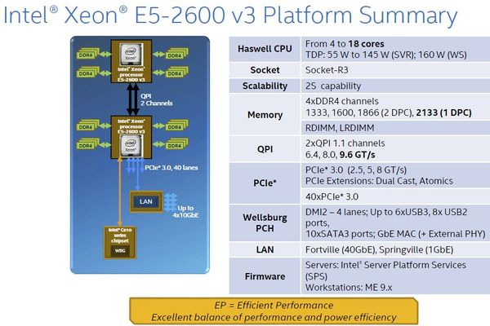
Intel: “Haswell-EP” (22 nm) Efficient Performance
Xeon as of 2015
Xeon E5-16xx v3 (uniprocessor): Cores 4-14
Xeon E5-26xx v3 (dual-processor): Cores 4-18
Xeon E5-46xx v3 (quad-processor): Core 6-18

Slide 24
Intel: Tick-Tock
Processor development model adopted in 2007
Repeat
Tick: Shrink die
Tock: New Microarchitecture
History: See Wikipedia

Slide 25
Outline
Architectural Approaches
Processor Architectures
Current Trends

Slide 26
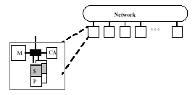
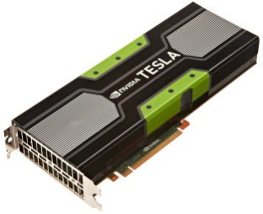
Clusters
Convergence towards generic parallel machine
Node = one or more procs., memory, Network assist.
Network = commodity, scalable, topology independent
Ride the technology curve!
But add accelerators at the node level

Slide 27
Evolving Programming Models
Multicore
Directives (eg OpenMP)
Mixed models (eg. Cilk)
Libraries (eg. Intel TBB)
Cluster – Message passing (eg. MPI)
GPUs – CUDA, OpenCL, OpenACC
Clouds – Message queues (eg. ZeroMQ)
Big Data Clusters - Map/Reduce & Hadoop

Slide 28
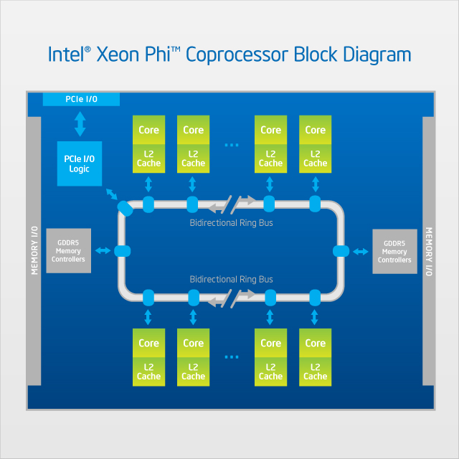
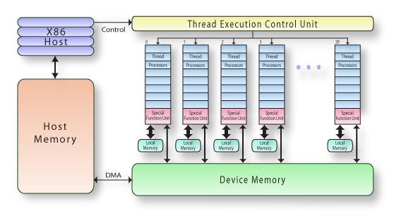
Accelerators
GPU
Thousands of simple cores
Mixed SIMD/MIMD
4 types of memory
Custom code
Intel Phi
10’s of simple cores
MIMD
4 types of memory
Same code recompiled

Slide 29
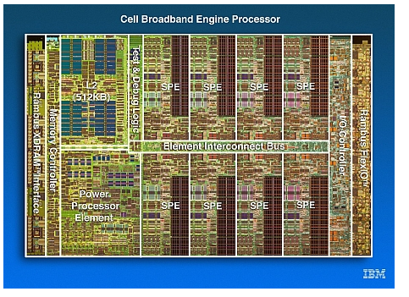
IBM Cell processor

Slide 30
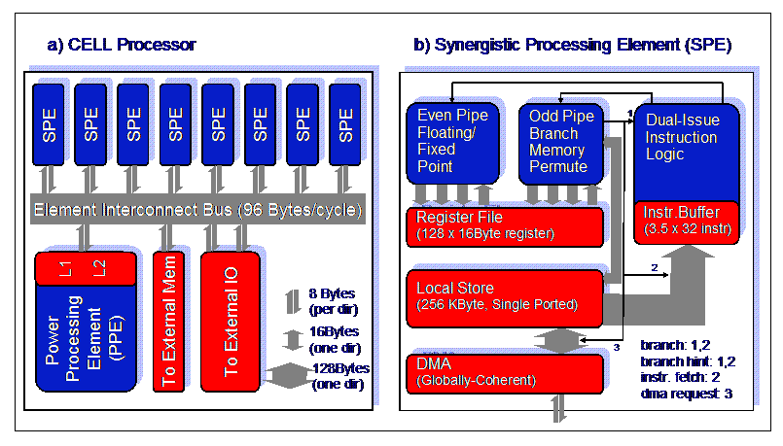
IBM Cell processor

Slide 32
FLOPS – Floating Point Operations Per Second
Name | FLOPS | When
yottaFLOPS | 10²⁴
zettaFLOPS | 10²¹
exaFLOPS | 10¹⁸ | 2020 ???
petaFLOPS | 10¹⁵ | Today for the biggest parallel machines
teraFLOPS | 10¹² | Today for a single multicore or accelerator
gigaFLOPS | 10⁹
megaFLOPS | 10⁶
kiloFLOPS | 10³

Slide 33
Rmax vs Rpeak
rank supercomputers based on their performance using the LINPACK Benchmark.
Rmax score = maximal achieved performance
Rpeak score = theoretical peak performance.
XSEDE system | Rmax | Rpeak
Stampede (TACC) | 5.17 petaFLOPS | 8.52 petaFLOPS
Kraken (NICS) | 961.9 teraFLOPS | 1.17 petaFLOPS
Keeneland (Georgia Tech) | 319.6 teraFLOPS | 614.5 teraFLOPS
Gordon (SDSC) | 285.8 teraFLOPS | 336.1 teraFLOPS
Lonestar (TACC) | 251.8 teraFLOPS | 301.8 teraFLOPS

Slide 34
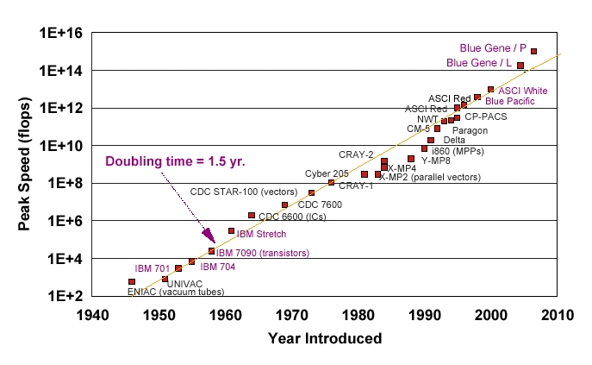
Peak Performance

Slide 38
500 Fastest Computers
Top 500: http://www.top500.org/
Breakdowns
http://www.top500.org/statistics/list/
Poster : http://s.top500.org/static/lists/2013/06/TOP500_201306_Poster.pdf

Slide 39
Exascale Computing Challenges
Exascale Report
1000 x today’s petascale architectures
System power is the primary constraint.
Target is 20-40 MW in 2020 for 1 exaflop
Clock frequencies likely decrease to conserve power
Will likely need billion-way concurrency
Memory bandwidth and capacity not keeping pace flops.
Current scaling approaches useless!

