Slide 1
www.Risk-Analytics-Lab.ca
HPC: Clusters, Clouds, & GPU
Risk Analytics
Algorithms, Statistics, Modeling, & Science
Lab Members: Postdocs, Ph.D. & MCS students, visiting researchers/interns, Advisors from Industry
Disciplines
Computer Science
Statistics
Civil Engineering
Oceanography
Economics
GIS
Management Information Systems
Model: Collaborative Research with Industrial Partners
Key Outputs
Highly qualified graduate students
Industrial strength prototypes
Peer reviewed publications
Andrew Rau-Chaplin arc@cs.dal.ca

Slide 2
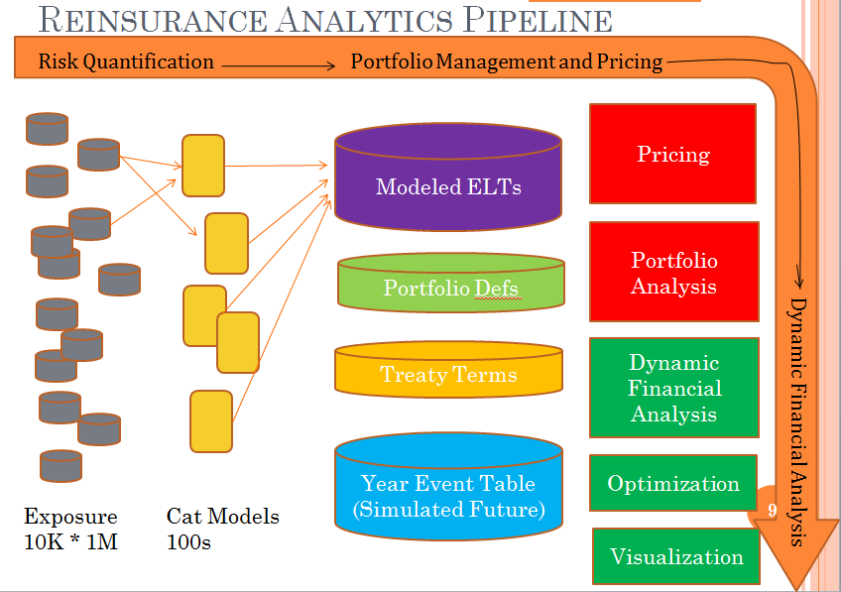
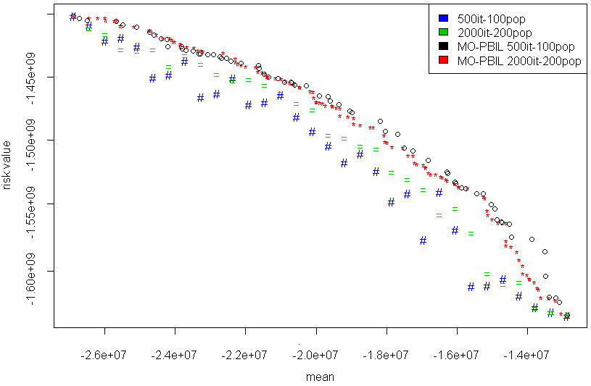
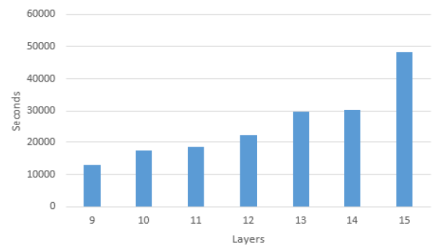
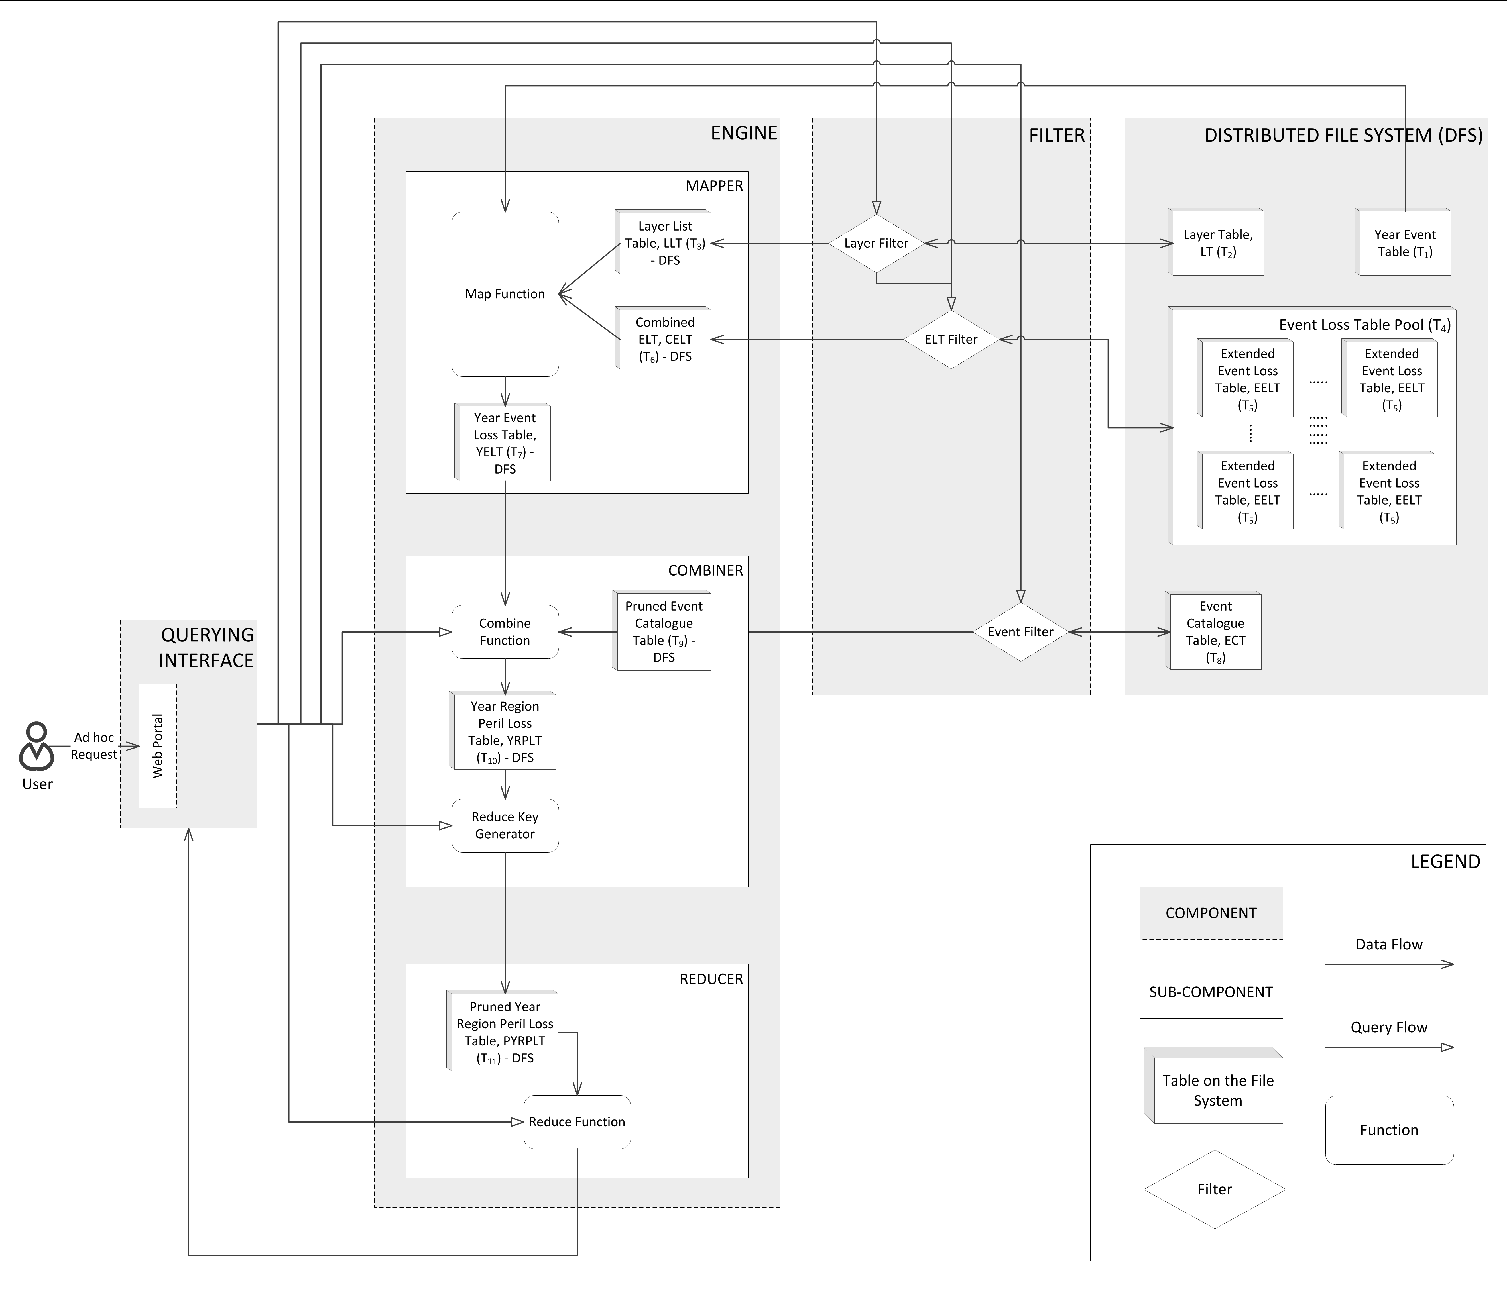
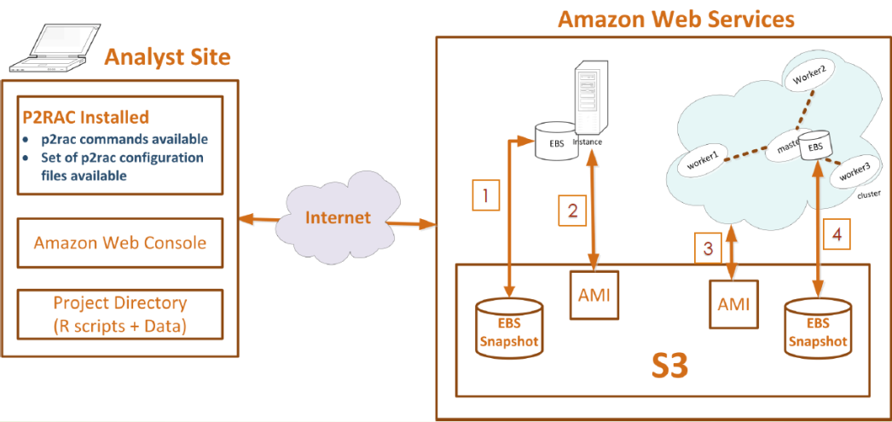
Some Recent Projects
Risk Portfolio Analysis
Treaty Optimization
A Hadoop based Risk Analytics Framework
P2RAC: Cloud based Analytics in R

