Slide 1
Academic Integrity
How to do it right

Slide 2
Why it matters
Virtually everything we know has come to us because someone else has taken the time to think about it, research it, and then share what they have learned.
All academic research is built on previous research and therefore, accurate, valid information is essential.
If you wanted to follow up on the previous research, you would need the relevant citations

Slide 3
Imagine
Imagine what would happen
  if a new drug therapy was founded on incorrect or false research
  if research that countered the current results was ignored

Slide 4
Academic culture
When you become a student, you become part of the academic culture. You are exploring and investigating new areas of interest and locating existing knowledge. This is research even though you may not be contributing new knowledge.
As part of the academic culture, you have the responsibility to conduct ethical research. Accurate citations and fair acknowledgment of information sources are essential.

Slide 5
The Real World
Plagiarism matters in the real world
Reporters - Jayson Blair, New York Times
Wikipedia – Use of Images > Key principles
Web sites – Plagiarism Today
Medical profession

Slide 6
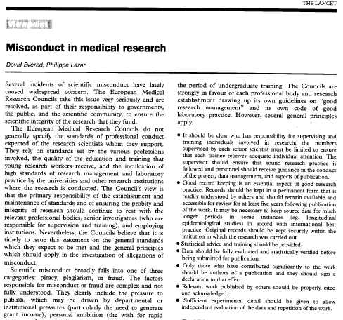
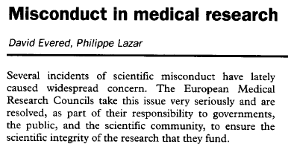

From Lancet

Slide 7
Acknowledgement
Academic research encourages (requires) an examination and awareness of previous research in order to provide a context for new research
It is expected that previous research that is consulted should be documented and when it is incorporated into new research it should be acknowledged or cited

Slide 8
Acknowledgement
Work that has been created by another person and used in the creation of a paper, web page or computer code must be cited even if it is not copyrighted – this does not just mean words, it includes images and code
Images must be cited even if they are
  Royalty free or freely available on the web
  Altered by the user
  Combined with another image

Slide 9
Questions
Ask yourself
  Am I giving people the impression that I created this image when I display it on my web page or in my document?
  Am I pretending authorship?
  Am I assuming people will know I didn’t create it
    If yes, then I am also assuming they will know where to access the image where it originally appeared
  Is the image copyrighted or trademarked?
    If yes, then I am misusing it if I don’t cite the source

Slide 10
Citation for a Web page
Page Title
Date of creation or last update
Author or Company name
Date it was accessed
Address of web page
“MySpace launches net music store.” 25 September 2008. British Broadcast Corp. 30 Sept. 2008 <http://news.bbc.co.uk/2/hi/technology/7635416.stm>.

Slide 11
Citation for an image
Artist or company name (if available)
Title of the work (if available; check alt text)
Date it was created or trademarked
Repository, museum, or owner (if applicable)
Date it was accessed
Web site address
  Python Software Foundation. Python logo. 1990-2008. Accessed 30 Sept. 2008. <http://www.python.org>

Slide 12
Paraphrasing
Goal
  Provides an understanding of the key points without including exact phrases or maintaining similar order of the original text
  Avoids over usage of quotes
  Helps you grasp the full meaning of the original

Slide 13
Paraphrasing
“Students frequently overuse direct quotation in taking notes, and as a result they overuse quotations in the final [research] paper. Probably only about 10% of your final manuscript should appear as directly quoted matter. Therefore, you should strive to limit the amount of exact transcribing of source materials while taking notes.” (Lester 46-47)
Lester, James D. Writing Research Papers. 2nd ed. New York: Scott Foresman, 1976.

Slide 14
Unacceptable paraphrase
Students often use too many direct quotations when they take notes, resulting in too many of them in the final research paper. In fact, probably only about 10% of the final copy should consist of directly quoted material. So it is important to limit the amount of source material copied while taking notes.
Same organization, order and length ; some exact phrases; no acknowledgement

Slide 15
Acceptable Paraphrase
In research papers students often quote excessively, failing to keep quoted material down to a desirable level. Since the problem usually originates during note taking, it is essential to minimize the material recorded verbatim (Lester 46-47).
Maintains the sense of the paragraph without using exact phrases or similar order; shorter; acknowledges source

Slide 16
Questions?

