Slide 1
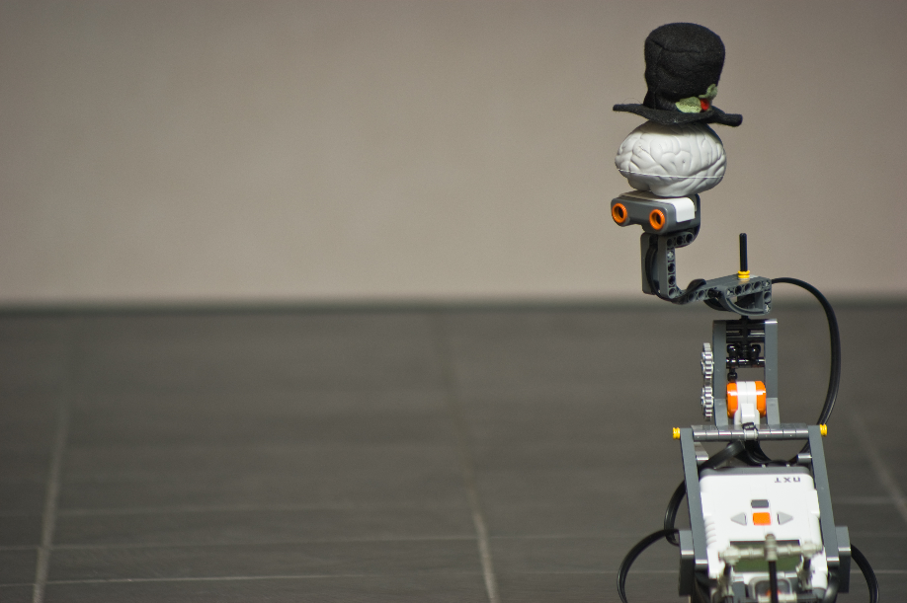
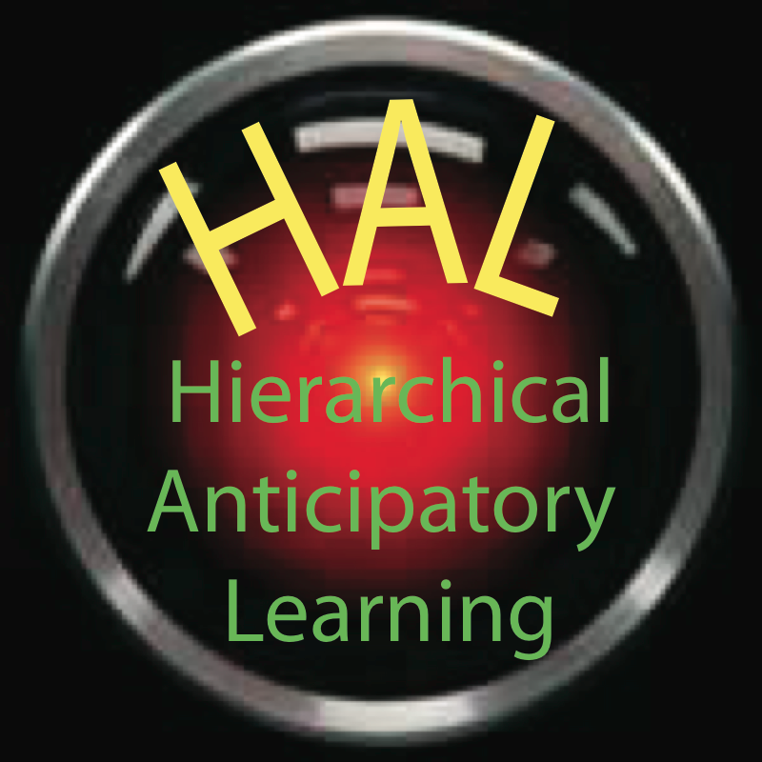
Autonomous Robotics: Supervised and unsupervised
learning
Thomas Trappenberg

Slide 2
Three kinds of learning:
Supervised learning
2. Unsupervised Learning
3. Reinforcement learning
Detailed teacher that provides desired output y for a given
input x: training set {x,y}
→ find appropriate mapping function y=h(x;w) [= W ϕ(x) ]
Unlabeled samples are provided from which the system has to
figure out good representations: training set {x}
→ find sparse basis functions b_{i} so that x=Σ_{i} c_{i} b_{i}
Delayed feedback from the environment in form of reward/
punishment when reaching state s with action a: reward r(s,a)
→ find optimal policy a=π*(s)
Most general learning circumstances

Slide 3
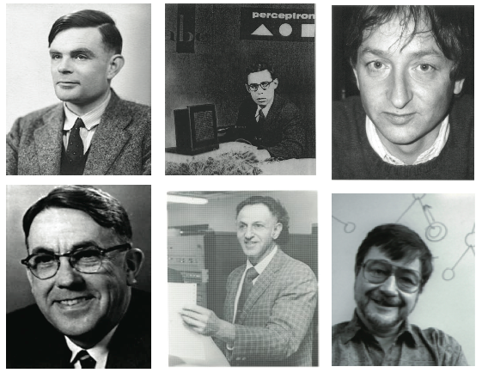
Some Pioneers

Slide 4
Supervised learning
Maximum Likelihood (ML) estimation: Give hypothesis h(y|x; Θ), what are the best parameters that describes the training data
Bayesian Networks How to formulate detailed causal models with graphical means
Universal Learners: Neural Networks, SVM & Kernel Machines What if we do not have a good hypothesis

Slide 5
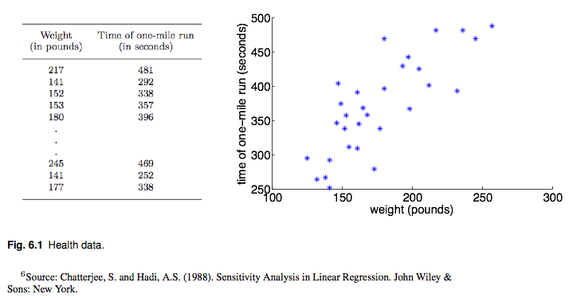
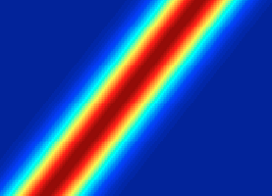
Goal of learning:
Make predictions !!!!!!!!!!!
learning vs memory
Fundamental stochastisity
Irreducible indeterminacy
Epistemological limitations
Sources of fluctuations →
→ Probabilistic framework

Slide 6
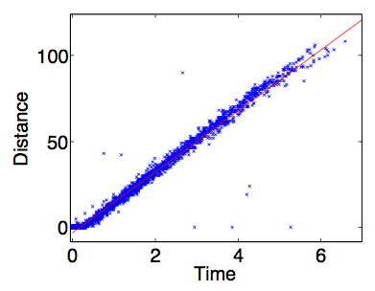
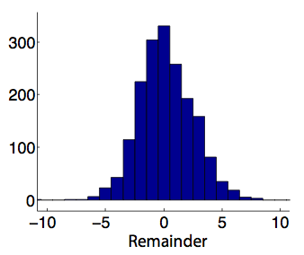
Plant equation for robot
Distance traveled when both motors
are running with Power 50
Goal of learning:

Slide 7
Hypothesis:
The hard problem: How to come up with a useful hypothesis
Learning: Choose parameters that make training data most likely
Assume independence of training examples
Maximum
Likelihood
Estimation
and consider this as function of parameters (log likelihood)

Slide 8
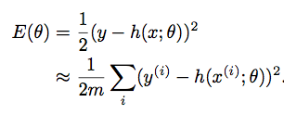
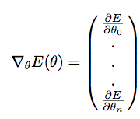
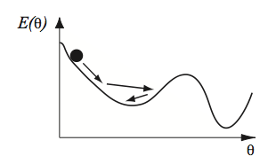
Minimize MSE
Random search
Look where gradient is zero
Gradient descent
Learning rule:

Slide 9
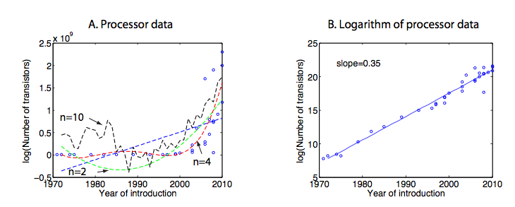
Nonlinear regression:
Bias-variance tradeoff

Slide 10
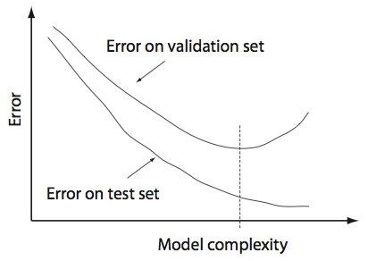
Nonlinear regression:
Bias-variance tradeoff

Slide 11
Feedback control
Adaptive control

Slide 12
MLE only looks at data …
What is if we have some prior knowledge of θ?
Bayes’ Theorem
Maximum a posteriori (MAP)

Slide 13
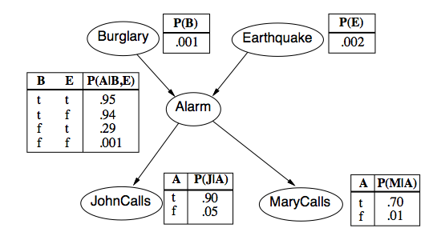
How about building more elaborate multivariate models?
Causal (graphical) models (Judea Pearl)
Parameters of CPT usually learned from data!

Slide 14
Hidden Markov Model (HMM) for localization

Slide 15
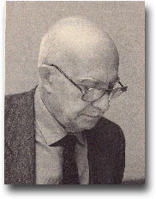
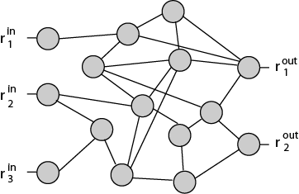
How about building more general multivariate models?
1961: Outline of a theory of Thought-Processes
and Thinking Machines
Neuronic & Mnemonic Equation
Reverberation
Oscillations
Reward learning
Eduardo Renato Caianiello (1921-1993)
But: NOT STOCHASTIC
(only small noise in weights)
Stochastic networks:
The Boltzmann machine
Hinton & Sejnowski 1983

Slide 16
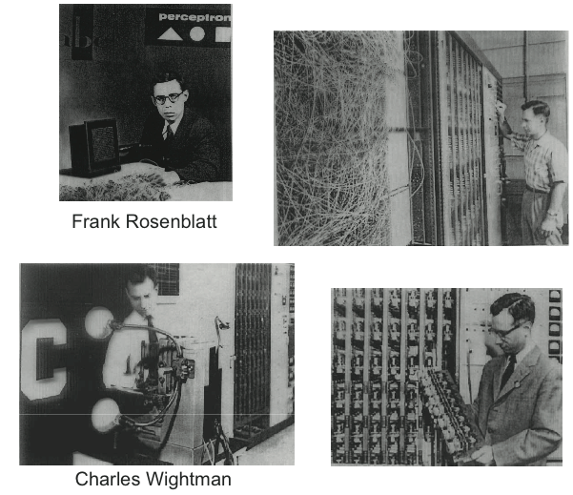

Slide 17
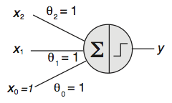
McCulloch-Pitts neuron
Also popular:
( )
Perceptron learning rule:

Slide 18
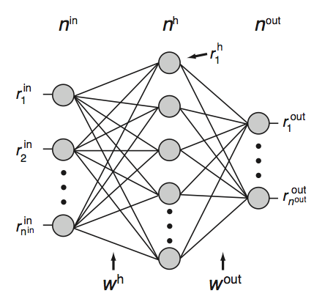
MultiLayer Perceptron (MLP)
Stochastic version can
represent density functions
Universal approximator (learner)
but
Overfitting
Meaningful input
Unstructured learning
Only deterministic units
(just use chain rule)

Slide 19
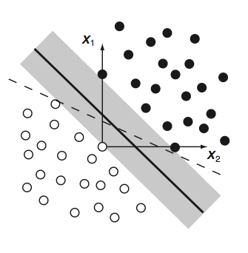
Linear large margin classifiers
→ Support Vector Machines (SVM)
MLP: Minimize training error
SVM: Minimize generalization error
(empirical risk)

Slide 20
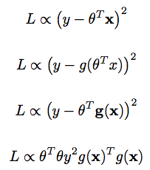
Linear in parameter learning
Linear hypothesis
Non-Linear hypothesis
Linear in parameters
SVM in dual form
+ constraints
Thanks to Doug Tweet (UoT) for pointing out LIP

Slide 21
Linear in parameter learning
Primal problem:
Dual problem:
subject to

Slide 22
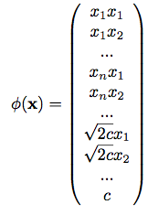
Nonlinear large margin classifiers → Kernel Trick
Transform attributes (or create new feature values from attributes)
and then use linear optimization
Can be implemented efficiently with Kernels in SVMs
Since data only appear as linear products
for example, quadratic kernel

Slide 23
2. Sparse Unsupervised Learning

Slide 24
Major issues not addressed by supervised learning
How to scale to real (large) learning problems
Structured (hierarchical) internal representation
What are good features
Lots of unlabeled data
Top-down (generative) models
Temporal domain

Slide 25
What is a good representation?
Sparse features are useful

Slide 26
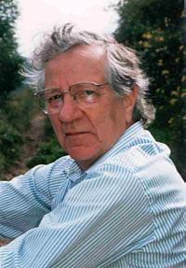
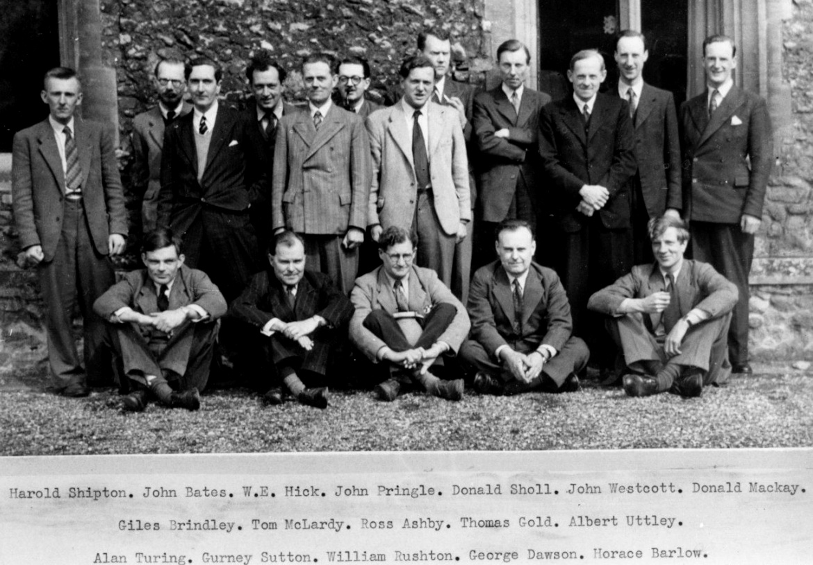
Horace Barlow
Possible mechanisms underlying the transformations
of sensory of sensory messages (1961)
``… reduction of redundancy is an important principle guiding the organization of sensory messages …”
Sparsness & Overcompleteness
The Ratio Club

Slide 27
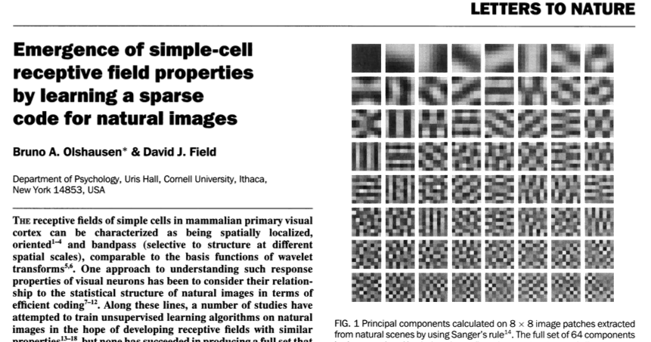
PCA
minimizing reconstruction error
and sparsity

Slide 28
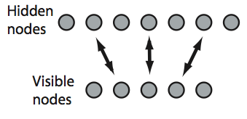
Self-organized feature representation by
hierarchical generative models

Slide 29
Restricted Boltzmann Machine (RBM)
Update rule: probabilistic units
(Caianello: Neuronic equation)
Training rule: contrastive divergence
(Caianello: Mnemonic equation)
Alternating
Gibbs Sampling

Slide 30
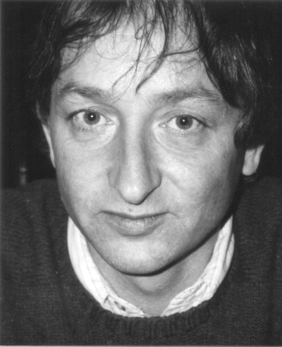
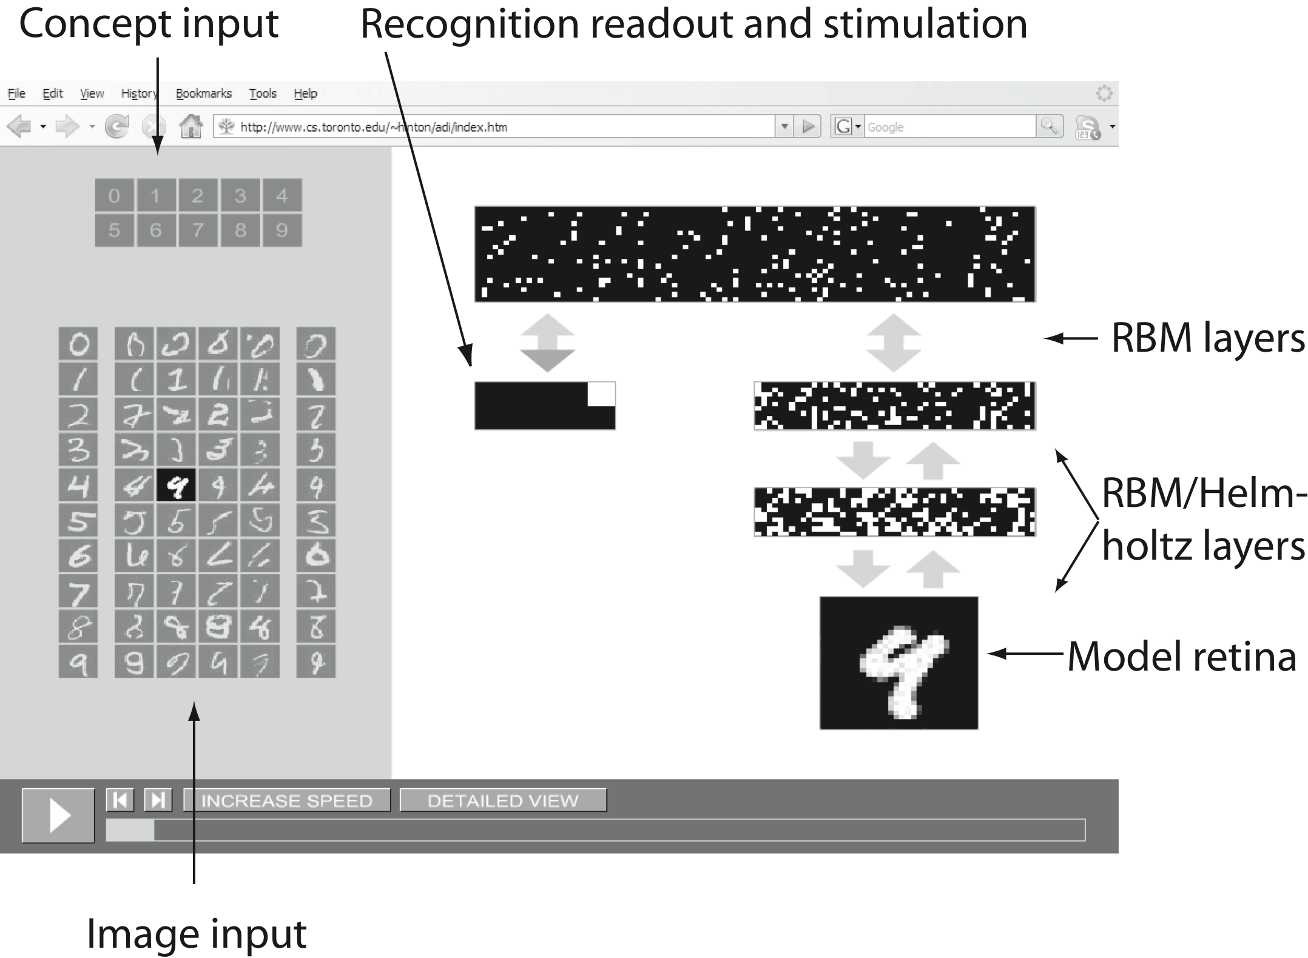
Deep believe networks:
The stacked Restricted Boltzmann Machine
Geoffrey E. Hinton

Slide 31
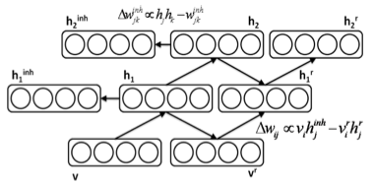
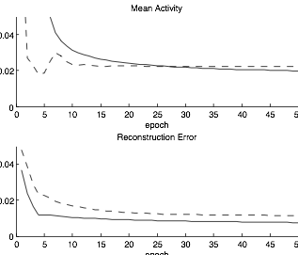
Sparse and Topographic RBM
… with Paul Hollensen

Slide 32
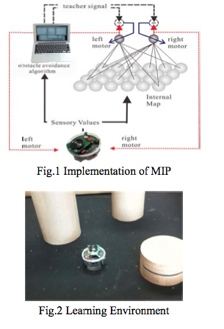
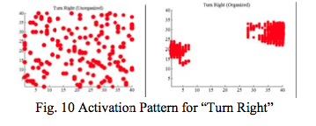
Map Initialized Perceptron (MIP)
…with Pitoyo Hartono

Slide 33
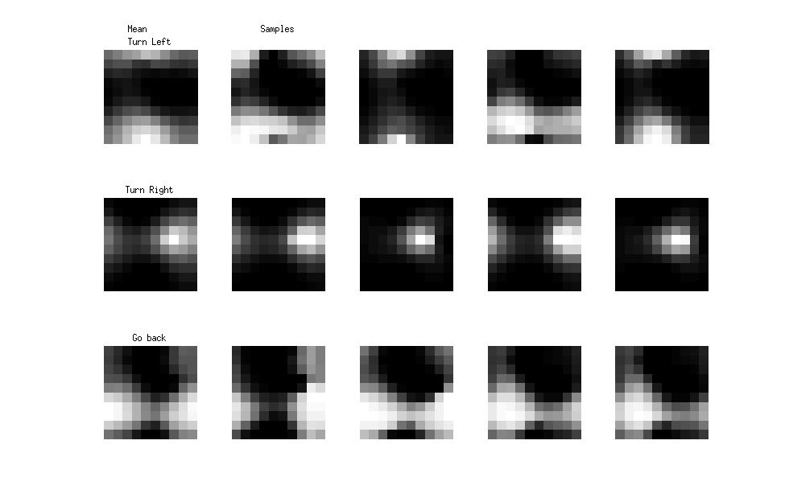
RBM features

Slide 34
