Slide 1
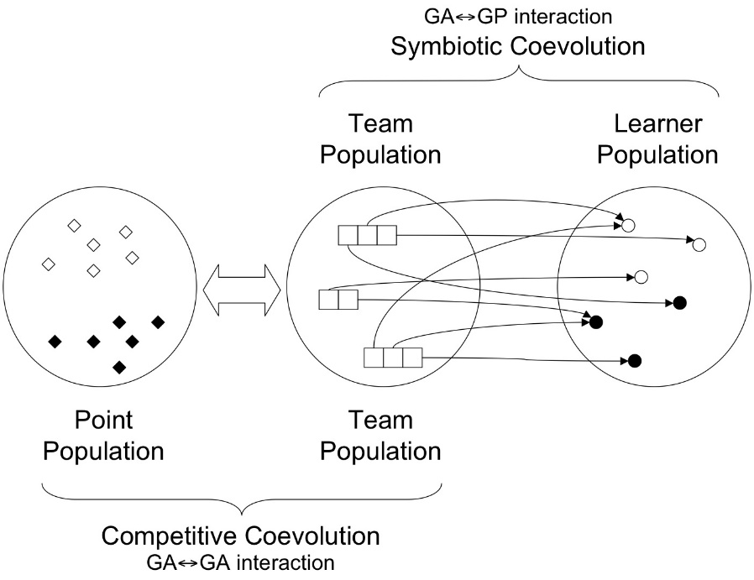
Symbiotic Bid-Based GP
Points are representations of the class labels; each point indexes a subset of the training data set under an active learning model.
Learners are individuals that are each assigned a given class label present in the Point population. They also maintain a set of instructions internally used to calculate a bid.
When a Learner wins a bid, we compare the Learner’s action label to the class label of the given Point. If the action label matches the Point’s class label, the Learner is rewarded. Otherwise the Learner is punished.

Slide 2
Symbiotic Bid-Based GP
Teams consist of Learners which are evaluated against a Point in the following manner:
The Learners use a set of instructions to tell their Team how certain they are that they know how to label a given Point.
We select the highest bid from the Learners and designate them the winner. If a Learner’s recommendation (bid) is accepted by the Team, the Learner will suggest their label for the given Point.
After all Teams are evaluated against all Points in a given generation, we remove the worst Points, Teams, and Learners, then create new members for each population and move to the next generation.

Slide 3
Point
Learner
Team

Slide 4
What kind of animal is this?

Slide 5
It’s a cat. I am an expert on cats.

Slide 6
In fact, I am 97.2% sure this is a cat.

Slide 7
I’m only 53% sure. I guess we should trust Steve.

Slide 8
Sure.
What’s a cat?

Slide 9
If the animal is a cat:

Slide 10
You are correct. This is a cat.

Slide 11
Great job, Steve.

Slide 12
If the animal is not a cat:

Slide 13
You are incorrect. This animal is a shark.

Slide 14
You suck, Steve.

Slide 16
References
Shark : http://upload.wikimedia.org/wikipedia/commons/5/59/Caribbean_reef_shark.jpg
Cat : http://www.thetimes.co.uk/tto/multimedia/archive/00342/114240651_cat_342943c.jpg

