Slide 1
Software Testing: Introduction
Iain McCowatt
http://exploringuncertainty.com
iain@exploringuncertainty.com
@imccowatt
imccowatt

Slide 2
Introductions
Who am I?
A Software Testing Consultant
Designing testing services for several global banks
Where seemingly innocuous bugs can destroy millions of dollars
Who are you?
What do you know about testing?

Slide 3
Definitions: Quality
What is “Quality”?

Slide 4
Definitions: Quality
Gerald Weinberg: “value to some person”
Quality is subjective:
It only exists in relation to peoples perceptions
Those perceptions may vary
Often it relates to the fulfillment of some (persons) need, or the value (to someone) attained through providing a solution to a problem

Slide 5
Definitions: Bugs
What is a “bug”?

Slide 6
Definitions: Bugs
Bolton & Bach: “something that bugs somebody who matters”
Kaner & Bach: “anything that causes an unnecessary or unreasonable reduction of the quality of a software product”
A bug is a relationship between a person and a software product:
If it reduces value to someone then it is a bug

Slide 7
Interlude: Requirements?
But what about requirements? Aren’t bugs simply cases where requirements have not been fulfilled?

Slide 8
Interlude: Requirements?
What is this?

Slide 9
Interlude: Requirements?
What is this?

Slide 10
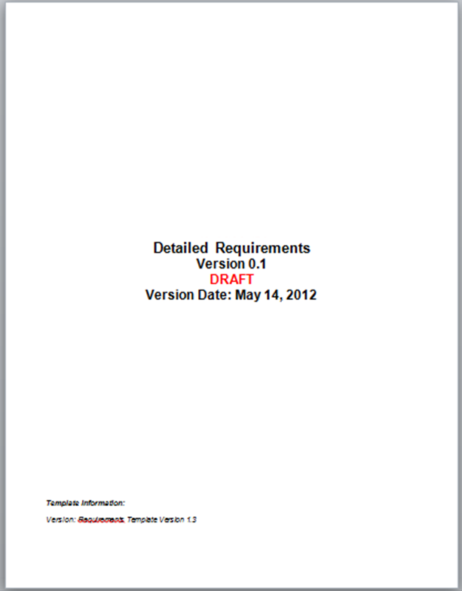
Interlude: Requirements?
What is this?

Slide 11
Interlude: Requirements?
What is this?
Ce ne sont pas
les requises.

Slide 12
Interlude: Requirements?
What are requirements?
An abstraction
A flawed representation of a someone’s flawed mental model as to a solution to some problem
Where that problem is not necessarily understood yet, and may have been articulated (another flawed representation of a flawed mental model) by someone else

Slide 13
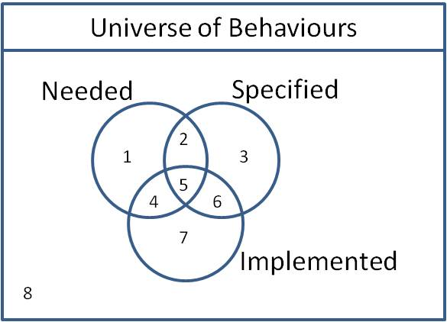
Interlude: Requirements?
Relying on requirements will miss important problems:
Unfulfilled needs?
Unexpected behaviour?
Undesired behaviour?
Conformance with specification has little value if the software solves the wrong problem
See “Spec Checking and Bug Blindness”, Iain McCowatt: http://exploringuncertainty.com/blog/archives/253

Slide 14
Exercise
Start MS Excel, or Calc etc.
Explore the font size feature
How many tests can you think of?
Can you find any bugs?

Slide 15
Exercise
What kinds of tests did you think of?
Different input methods
Boundaries
Rounding logic
Transitions
Feature interaction and other combinations
There are a very large number of potential tests
Can you test this feature in its entirety?

Slide 16
Exhaustive Testing
Consider this example:
In this trivial program, there are 5 paths from A to B.
The code may loop up to 20 times before exiting.
A
There are therefore approximately 120 trillion unique paths through this program. At 5 minutes per test case that’s over 1 billion years of effort, even with automation this is impossible.
Yet certain types of bug (e.g. resource leaks) are prevalent in such scenarios
Loop up
to 20 times
B
E
C
D
F
G
H
I

Slide 17
Exhaustive Testing
Exhaustive testing is impossible
To “test everything” we would have to:
Test every possible value of every input and output variable, and every possible combination of every variable
Test every possible INVALID value of every input and output variable, and the associated error handling
Test every possible path through the code
Test every possible event, combination of events, including timing, overlaps and sequencing
Test every possible software configuration, hardware configuration and combination of hardware / software configurations
Etc.

Slide 18
Exhaustive Testing
Testing can prove the presence but not absence of defects:
As exhaustive testing is impossible, it is impossible to find all the defects
As it is impossible to find all the defects, it is impossible to prove that the software “works”
To quote Einstein:
“No amount of experimentation can ever prove me right, a single experiment can prove me wrong”

Slide 19
Definitions: Testing
If we can’t prove that it works, why do we test software?
What is testing anyway?

Slide 20
Definitions: Testing
Cem Kaner: “Software Testing is an empirical technical investigation conducted to provide stakeholders with information about the quality of the product or service under test”
In other words, a test is an experiment designed to reveal information about software quality

Slide 21
The Mission of Testing
If we can’t prove that it works, why do we test software?
Possible missions might include:
Find the important bugs
Help make release decisions
Identify issues and workarounds to help reduce support costs
Identify safe usage scenarios
Discover product behaviour in certain scenarios
Assess compliance vs. regulations, standards, specifications
Demonstrate compliance to reduce liability
Reverse engineer an existing solution
Etc.

Slide 22
The Mission of Testing
Each of these missions relates to providing information, and will vary depending on context
Testing is context dependant
Would you test the autopilot of an airliner in the same way as website?
“There are good practices in context, but there are no best practices” - Cem Kaner, James Bach

Slide 23
Context
A variety of factors will affect selection of practices:
Degree and type of risk, e.g. safety critical, financial impact, time to market, reputational risk
Degree of solution complexity, e.g. system of systems
Degree of project complexity, e.g. team composition, contractual factors, geographic factors
Development lifecycle / methodology, e.g. Waterfall vs. Iterative
Nature of solution, e.g. COTS vs. new development
Constraints, e.g. time, cost, available skills
Compliance requirements; legislative / regulatory, standards, policy, process & procedure
Available information; requirements, design, models
Team dynamics; collaboration, access to stakeholders, developers, analysts, architects etc.
Target customers / users, and the degree to which their needs are understood

Slide 24
Exercise
Back to MS Excel, or Calc etc.
Explore the font size feature
How do you know the result of using this feature (i.e. the resulting font size) is “right”?
How would you test this?

Slide 25
Oracles
Testing is often viewed as checking actual results vs. expected results
Under this view, an oracle is a reference function or other model that enables you to determine expected results
This is problematic:
Does such a function exist?
Is it feasible to create such a function?
Does the function factor all conditions that might affect the outcome of a test?
Can the function be considered “right” in all cases that matter?

Slide 26
Oracles
An alternate view (Kaner, Bach):
“It works” really means “It appears to meet some requirement to some degree”
￼An oracle is a heuristic principle or mechanism by which you recognize a potential problem
ALL oracles are heuristic, that is to say fallible but possibly useful
An oracle does not need to be complete or infallible to be useful
Even without a formal oracle, it is possible to test (see assigned reading).

Slide 27
Summary
Quality is value to some person, and a bug is a relationship between some person and the software product
Exhaustive or “complete” testing is impossible
A test is an experiment designed to reveal information about software quality
Our specific information objectives, and therefore the practices we adopt, are driven by project context
All oracles are heuristic, and testing is not simply a matter of checking vs. expected results
Testing is an intractable problem for which there is no correct or optimal solution

Slide 28
Readings and Preparation for Next Week
Assigned reading: on heuristic oracles: http://www.testingeducation.org/BBST/foundations/Bolton_2005-01-TestingWithoutAMap.pdf
Next week we will be discussing Test Management
You should already be familiar with the Heuristic Test Strategy Model from your assignment. If you have not started this yes, please familiarize yourself with it: http://www.testingeducation.org/BBST/foundations/Bach_satisfice-tsm-4p-1.pdf

Slide 29
Further Information
Much of the content of this lecture has been inspired or derived from the Black Box Software Testing (BBST) series of courses by Kaner, Bach and others:
Additional information, such as video lectures, exercises and readings are available from:
http://www.testingeducation.org/BBST/

