Slide 1
Other Software Processes
Project management
Inspection
Configuration management
Change management
Process management

Slide 2
Other Processes
Development Process is the central process around which others revolve
Methods for other processes often influenced by the dev process
We have looked at various models for dev process
a “real” process likely derived from a model

Slide 3
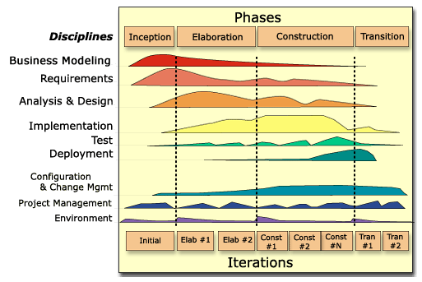
Other Processes In the context of Dev Processes

Slide 4
Other Processes
Project management process
Inspection process
Configuration management process
Change management process
Process management process
Will briefly look at these now

Slide 5
Project Management Process

Slide 6
The Typical PMs Role
Overall responsibility for the successful planning, execution, monitoring, control and closure of a project.
Primary point of contact with project sponsors
Key tasks
Plans
Meets
Communicates
Project Management == Leadership

Slide 7
10 Qualities of a PM
Inspires a Shared Vision
Good Communicator
Integrity
Enthusiasm
Empathy
Competence
Ability to Delegate Tasks
Cool Under Pressure
Team-Building Skills
Problem Solving Skills

Slide 8
What does a PM do?
Development process divides development into phases and activities
To execute it efficiently, must allocate resources, manage them, monitor progress, take corrective actions, …
These are all part of the PM process
Hence, PM process is an essential part of executing a project

Slide 9
PM Process Phases
There are three broad phases
Before: Planning
During
Monitoring and control
Communication facilitation
After: Postmortem analysis
Planning is a key activity that produces a plan, which forms the basis of monitoring

Slide 10
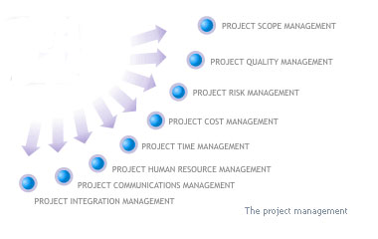
Project Management Concerns

Slide 11
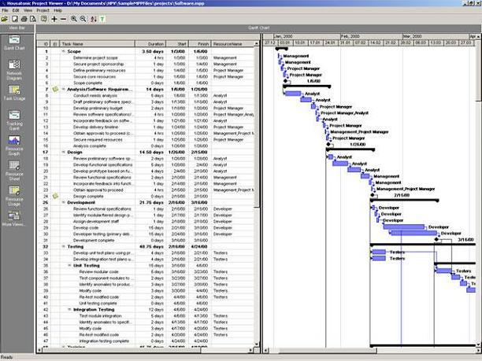
Project Management Tools

Slide 12
Planning
Done before project begins
Key tasks
Cost and schedule estimation
Staffing
Monitoring and risk mgmt plans
Quality assurance plans
Etc.
Will discuss planning in detail later

Slide 13
Monitoring and control
Lasts for the duration of the project and covers the development process
Monitors all key parameters like cost, schedule, risks
Takes corrective actions when needed
Needs information on the dev process – provided by metrics

Slide 14
Communication Facilitation
Realistically no plan covers everything!
Additional decisions are made during development
Documents should be updated and communicated
Typical environment
Multiple teams
Multiple user groups
Multiple disciplines
Multiple locations
In many setting PM is center of communication hub
Will discuss in more detail later

Slide 15
Postmortem Analysis
Postmortem analysis is performed when the development process is over
Basic purpose:
to analyze the performance of the process, and identify lessons learned
Improve predictability and repeatability
Central to a “Learning Organization” or culture
Also called termination analysis

Slide 16
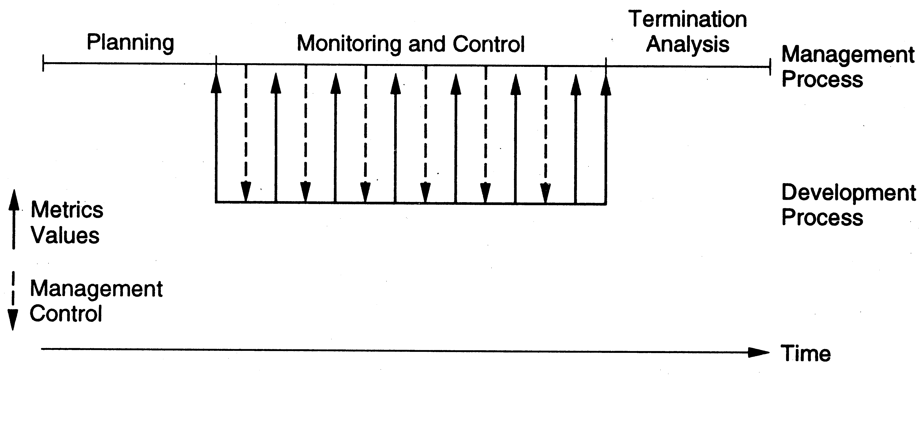
Relationship with Dev Process

Slide 17
The Inspection Process

Slide 18
Background
Main goal of inspection process is to detect defects in work products
First proposed by Fagan in 70s
Earlier used for code, now used for all types of work products
Is recognized as an industry best practice
Data suggests that it improves both Q&P
http://en.wikipedia.org/wiki/Fagan_inspection

Slide 19
Background
“A defect is an instance in which a requirement is not satisfied.” [Fagan, 1986]
Defects injected in sw at any stage
Hence must remove them at every stage
Inspections can be done on any document including design docs and plans
Is a good method for early phases like requirements and design
Also useful for plans (PM plans, CM plans, testing plans,…)

Slide 20
Some Characteristics
Conducted by group of technical people for technical people (i.e. review done by peers)
Is a structured process with defined roles for the participants
The focus is on identifying problems, not resolving them
Review data is recorded and used for monitoring the effectiveness

Slide 21
Steps in Typical Review Process

Slide 22
Planning
Select the group review team – three to five people group is best
Identify the moderator – has the main responsibility for the inspection
Prepare package for distribution – work product for review plus supporting docs
Package should be complete for review

Slide 23
Overview and Self-Review
A brief meeting – deliver package, explain purpose of the review, intro,…
All team members then individually review the work product
Lists the issues/problems they find in the self-preparation log
Checklists, guidelines are used
Ideally, should be done in one sitting and issues recorded in a log

Slide 24
Self-Review Log
Project name:
Work product name and ID:
Reviewer Name:
Effort spent (hours):
Defect list
No | Location | Description | Criticality

Slide 25
Group Review Meeting
Purpose – define the final defect list
Entry criteria
each member has done a proper self-review
logs are reviewed
Group review meeting
A reviewer goes over the product line by line
At any line, all issues are raised
Discussion follows to identify if a defect
Decision recorded (by the scribe)

Slide 26
Group Review Meeting…
At the end of the meeting
Scribe presents the list of defects/issues
If few defects, the work product is accepted; else it might be asked for another review
Group does not propose solutions
though some suggestions may be recorded
A summary of the inspections is prepared
useful for evaluating effectiveness

Slide 27
Group Review Meeting…
Moderator is in-charge of the meeting and plays a central role
Ensures that focus is on defect detection and solutions are not discussed/proposed
Work product is reviewed, not the author of the work product
Amicable/orderly execution of the meeting
Uses summary report to analyze the overall effectiveness of the review

Slide 28
Summary Report Example
Project Work Product Type Size of work product Review team Effort (person hours) Preparation Group meeting Total | XXXX Project plan 14 pages P1, P2, P3 10 (total) 10 20

Slide 29
Summary Contd.
Defects No of critical defects No of major defects No of minor defects Total Review status Reco for next phase Comments | 0 3 16 19 Accepted Nil Nice plan

Slide 30
Rework and Follow Up
Defects in the defects list are fixed later by the author
Once fixed, author gets it OKed by the moderator, or goes for another review
Once all defects/issues are satisfactorily addressed, review is completed and collected data is submitted

Slide 31
Roles and Responsibilities
Main roles
Moderator – overall responsibility
Author –Listen, inform, avoid defensiveness
Reviewer(s) – to identify defects
Reader – not there in some processes, reads line by line to keep focus
Scribe – records the issues raised

Slide 32
Guidelines for Work Products
Work Product | Inspection focus | Participants
Req Spec | Meet customer needs Are implementable Omissions, inconsistencies, ambiguities | Customer Designer Tester, Dev Analyst
HLD | Design implements req Design is implementable Ommissions, quality of design | Req author Designer Developer

Slide 33
Guidelines for Work Products
Code | Code implements design Code is complete and correct Defects in code Other quality issues | Designer Tester Developer
Test cases | Set of test cases test all SRS conditions Test cases are executable Are perf and load tests there | Req author Tester Proj mgr
Proj Mgmt Plan | Plan is complete and specifies all components of the plan Is implementable Omissions and ambiguities | Proj mgr Another Proj mgr

Slide 34
Summary
Purpose of reviews: to detect defects
Structured reviews are very effective - can detect most of the injected defects
For effective review, process has to be properly defined and followed
Data must be collected and analyzed

Slide 35
Configuration Management Process

Slide 36
Background
A software project produces many items - programs, documents, data, manuals, …
All of these can be changed easily – need to keep track state of items
Software Configuration Management (SCM)
Systematically control the changes
Focus on changes during normal evolution (req changes will be handled separately)
CM requires discipline as well as tools

Slide 37
Background
SCM often independent of dev process
Dev process looks at macro picture, but not on changes to individual items/files
As items are produced during dev they are brought under SCM
SCM controls only the products of the development process

Slide 38
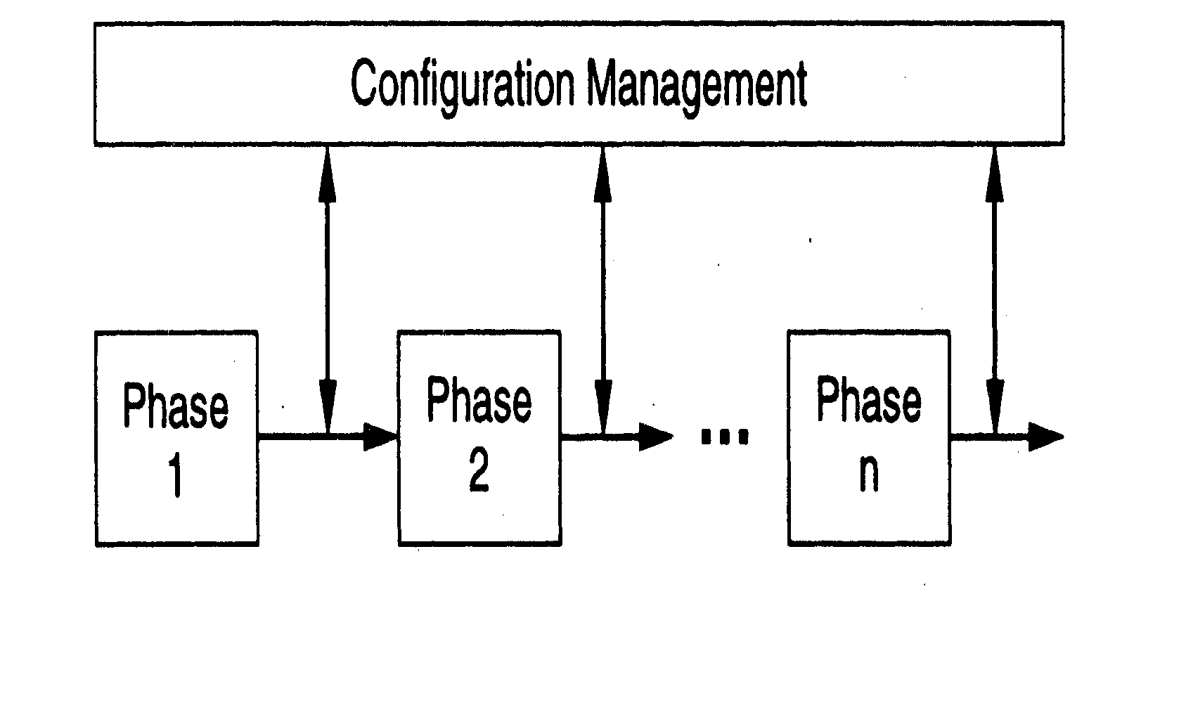
SCM Process and Dev process

Slide 39
Need for CM
CM needed to deliver product to the client
What files should comprise the product?
What versions of these files?
How to combine these to make the product?
Just for this, versioning is needed, and state of different items has to be tracked
There are other functions of CM also

Slide 40
Functionality Needed
Capture current state of programs
Capture latest version of a program
Undo a change and revert back to a specified version
Prevent unauthorized changes
Gather all sources, documents, and other information for the current system

Slide 41
CM Mechanisms
Configuration identification and baselining
Version control
Access control
These are the main mechanisms, there are others like
naming conventions,
directory structure,…

Slide 42
Configuration Items
Sw consists of many items/artifacts
In CM some identified items are placed under CM control
Changes to these are then tracked
Periodically, system is built using these items and baselines are established
Baseline – logical state of the system and all its items; is a reference point

Slide 43
Version and access control
Key issues in CM
Done primarily on source code through source code control systems, which also provide access control
Allows older versions to be preserved and hence can undo changes
Examples:
CVS – Original open source system (1986)
Subversion – Open source CVS replacement (1999)
Microsoft Visual SourceSafe (VSS) – targeted for smaller dev projects
IBM Rational ClearCase – Industrial strength solution

Slide 44
Version and Access Control
When programmer developing code – is in private area
When code is made available to others, it goes in an access-controlled library
For making changes to an item in library, it has to be checked out
Changes made by checking-in the item – versioning is automatically done
Final system is built from the library

Slide 45
Version/Access Control
Generally both version and access control done through CM tools
Tools limit access to specified people - formal check in, check out procedures
Automatic versioning done when a changed file is checked-in
Check-in, check-out control may
be restricted to a few people in a project
Require successful compile/build cycle

Slide 46
CM Process
Defines the activities for controlling changes
Main phases
CM Planning
Executing the CM process
CM audits

Slide 47
CM Planning
Identify items to be placed under CM
Define library structure for CM
Define change control procedures
Define access control, baselining, reconciliation, procedures
Define release procedure

Slide 48
CM Audit
During project execution CM procedures have to be followed (e.g. moving items between directories, naming, following change procedures, …)
Process audit has to be done
CM audit can also check if items are where they should be

Slide 49
Summary – CM
CM is about managing the different items in the product, and changes in them
Developing a CM plan at the start is the key to successful to CM
CM procedures have to be followed; audits have to be performed
Requires discipline and tools

Slide 50
Requirements Change Management Process

Slide 51
Background
Requirements change at any time during the development
Changes impact the work products and the various configuration items
Uncontrolled changes can have a huge adverse impact on project in cost/sched
Changes have to be allowed, but in a controlled manner

Slide 52
A Change Mgmt Process
Log the changes
Perform impact analysis on the work products and items
Estimate impact on effort and schedule
Review impact with stakeholders
Rework the work products/items

Slide 53
Changes
Change often triggered by change request
Change req log keeps a record of requests
Impact analysis for a change request involves identifying the changes needed to diff items, and the nature of change
The impact of changes on the project is reviewed to decide whether to go ahead
Cumulative changes also often tracked

Slide 54
Process Management Process

Slide 55
Background
A process is not a static entity – it has to change to improve to improve the Q&P
Focus of process management is to evaluate and improve the process
Is different from project management which focuses on a project
Process management is an advanced topic

Slide 56
Software Process Improvement
To improve the process, an org must understand the current process
Requires process be properly documented
Properly executed on projects
Data is collected from projects to understand the performance of process on projects
Changes to process are best made in small increments

Slide 57
Software Process Improvement Frameworks
What changes should be made to the process and when
Frameworks suggest ways of how process improvement can proceed
Capability Maturity Model (CMM) is one of the most common frameworks

Slide 58
CMM
CMM has five maturity levels for a software process (level 1 is ad-hoc)
In a level, process has some capabilities and lays the foundation for next level
For moving from one level to another, CMM specifies areas to focus on
Is used heavily by sw industry

Slide 59
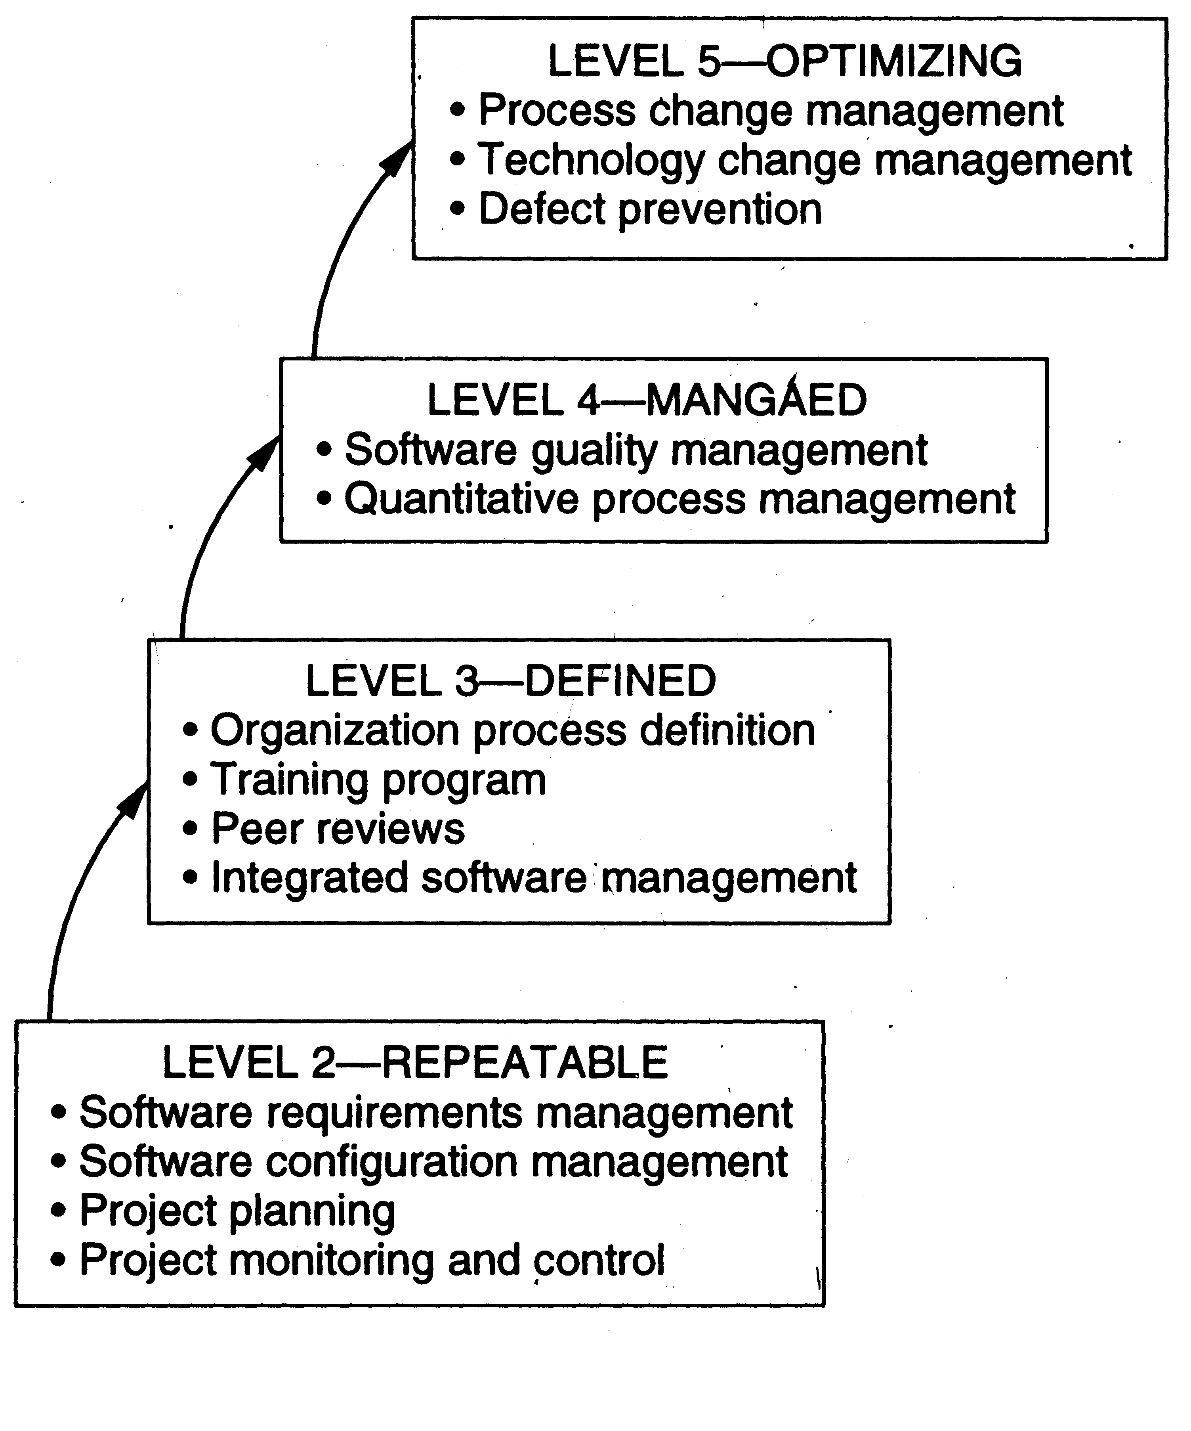
CMM
Note:
Student projects: CMM level 1
SW Engg. Course Project: CMM level 2

Slide 60
Course Project Notes
Decide on roles and responsibilities
Possible Roles
Project management & Change management process
Web site, Charter & Feasibility Doc, SRS & Project Plan, Meeting minutes
Design & Dev Lead
Design Docs
Inspection Lead
reviews of other group’s work products
Configuration Management Lead
Setup and management of version control and build system
Quality Assurance & Testing Lead
Test Docs, User manuals

Slide 61
Course Project Notes
Project Charter and Feasibility Doc
Authorizes the project, describes the Why, What, How, Who and When.
The customer,
A problem statement (the business problem to be solved?),
Project Description (the approach to be taken?),
Goals, Objectives, and Design principles (How do you know if you are successful? What do you value?)
The project scope (What is specifically included and excluded),
Critical success factors (What is key to success, what are the key risks, and mitigation plans),
Any assumptions and/or constraints
Project organization,
Major milestones, and
Roles and responsibilities.
Anchors a project helping the team avoid mid project drift.
Every project needs a charter! If the sponsor doesn't provide it, the development team should create one and get it approved!
See the Templates Directory for a number of Project Charter Templates.

